Slide 1

JS runtime
Yossi Arye
Based on Philip Roberts

Slide 2
Philip Roberts
The lecturer I based on.
The lecture received about 2.5 million views, as of mid-2022.
Link: https://www.youtube.com/watch?v=8aGhZQkoFbQ&t=621s
I found some inaccuracies in the lecture, but still is a good basic.

Slide 3
Terms
JS engine
JS runtime
Call stack
Heap
Event loop
Task queue (Callback queue)
Web API setTimeout, DOM, HTTP request

Slide 4
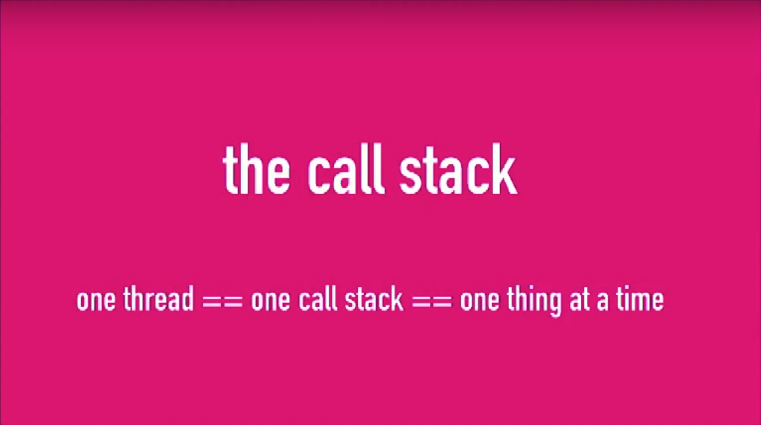
JS single threaded language
JS is a single threaded language which means that only one set of instructions can be executed at a time. There is only one call stack.

Slide 5
JS Engine
The JavaScript engine is simply a computer program that executes JavaScript code. JavaScript engines are inbuilt in all the modern browsers today. When the JavaScript file is loaded in the browser, JavaScript engine will execute each line of the file from top to bottom (to simplify the explanation we are avoiding hoisting in JS). JavaScript engine will parse the code line by line, convert it into machine code and then execute it.

Slide 6
JS Engine
Every browser has its own JavaScript engine but the most well known engine is Google’s V8. The V8 engine powers Google Chrome but also Node.js which is JavaScript Runtime.

Slide 7
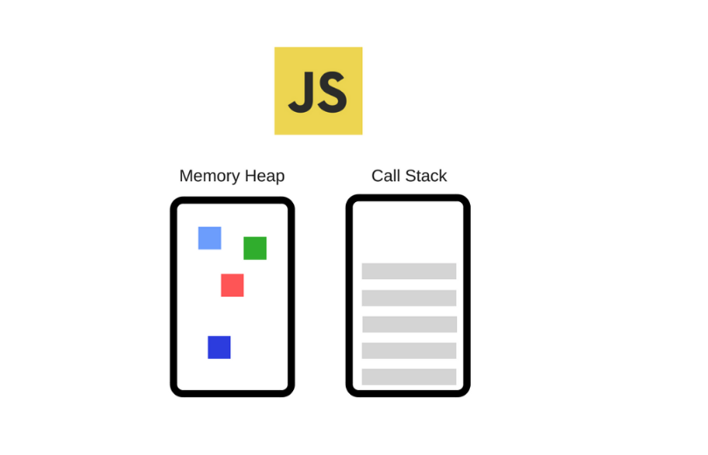
JS Engine
The Engine consists of two main components:
Memory Heap — this is where the memory allocation happens.
Call Stack — this is where your stack frames are as your code executes.

Slide 8
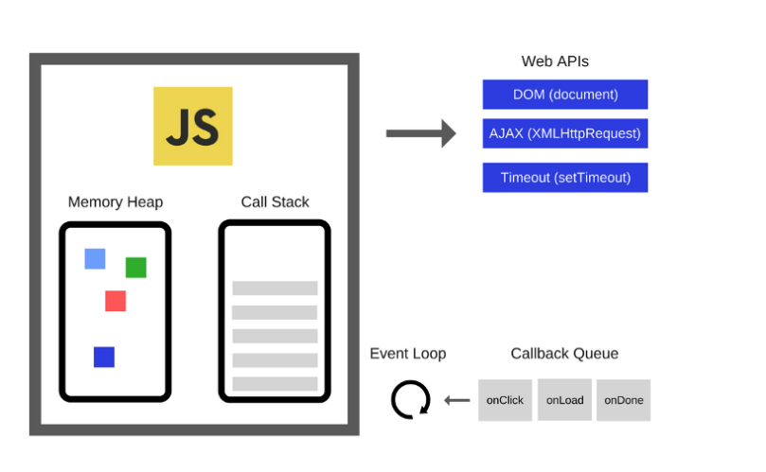
Js Runtime
JavaScript Runtime is just like a box or a container including all the things that we need to use JavaScript. And to the heart of any JavaScript Runtime is always JavaScript Engine. In the context of a browser, this is comprised of the following elements:
The JavaScript engine
Web APIs
The callback queue
The event loop

Slide 9
Web API vs Global API
The browser comes with the web API which is not native to JS. The web API can take care of asynchronous actions. You can access the web API by using methods on the window object. If we look at the Node.js, which is a runtime that enables us to run JS outside of the browser written in C++, it uses the V8 engine from the browser but extends it with a global API instead of the web API the browser uses.

Slide 10
Call Stack
It's a data structure which records where in the program we are, if we step into a function, we put something onto the stack, if we return from a function, we pop off the top of the stack.

Slide 11
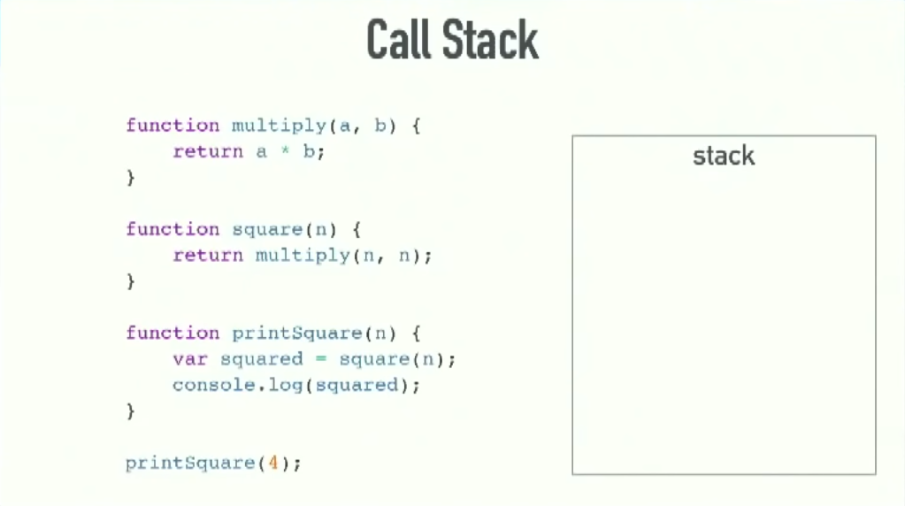
Call Stack

Slide 12
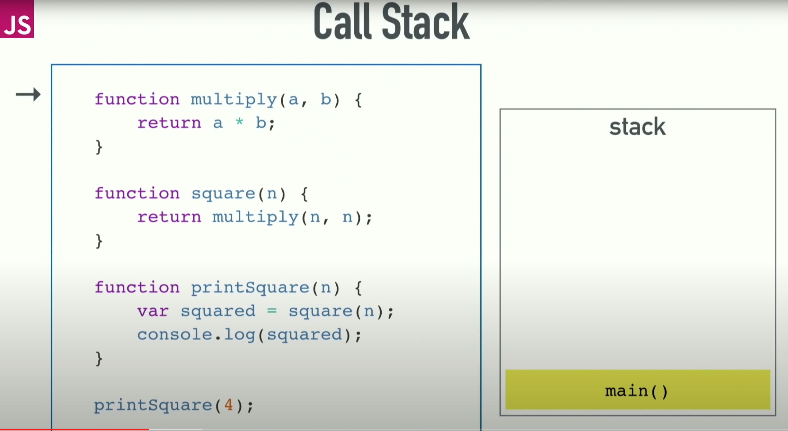
Call Stack

Slide 13
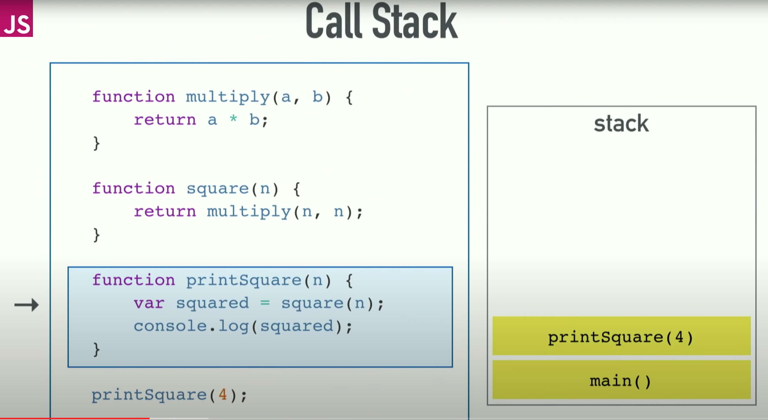
Call Stack

Slide 14
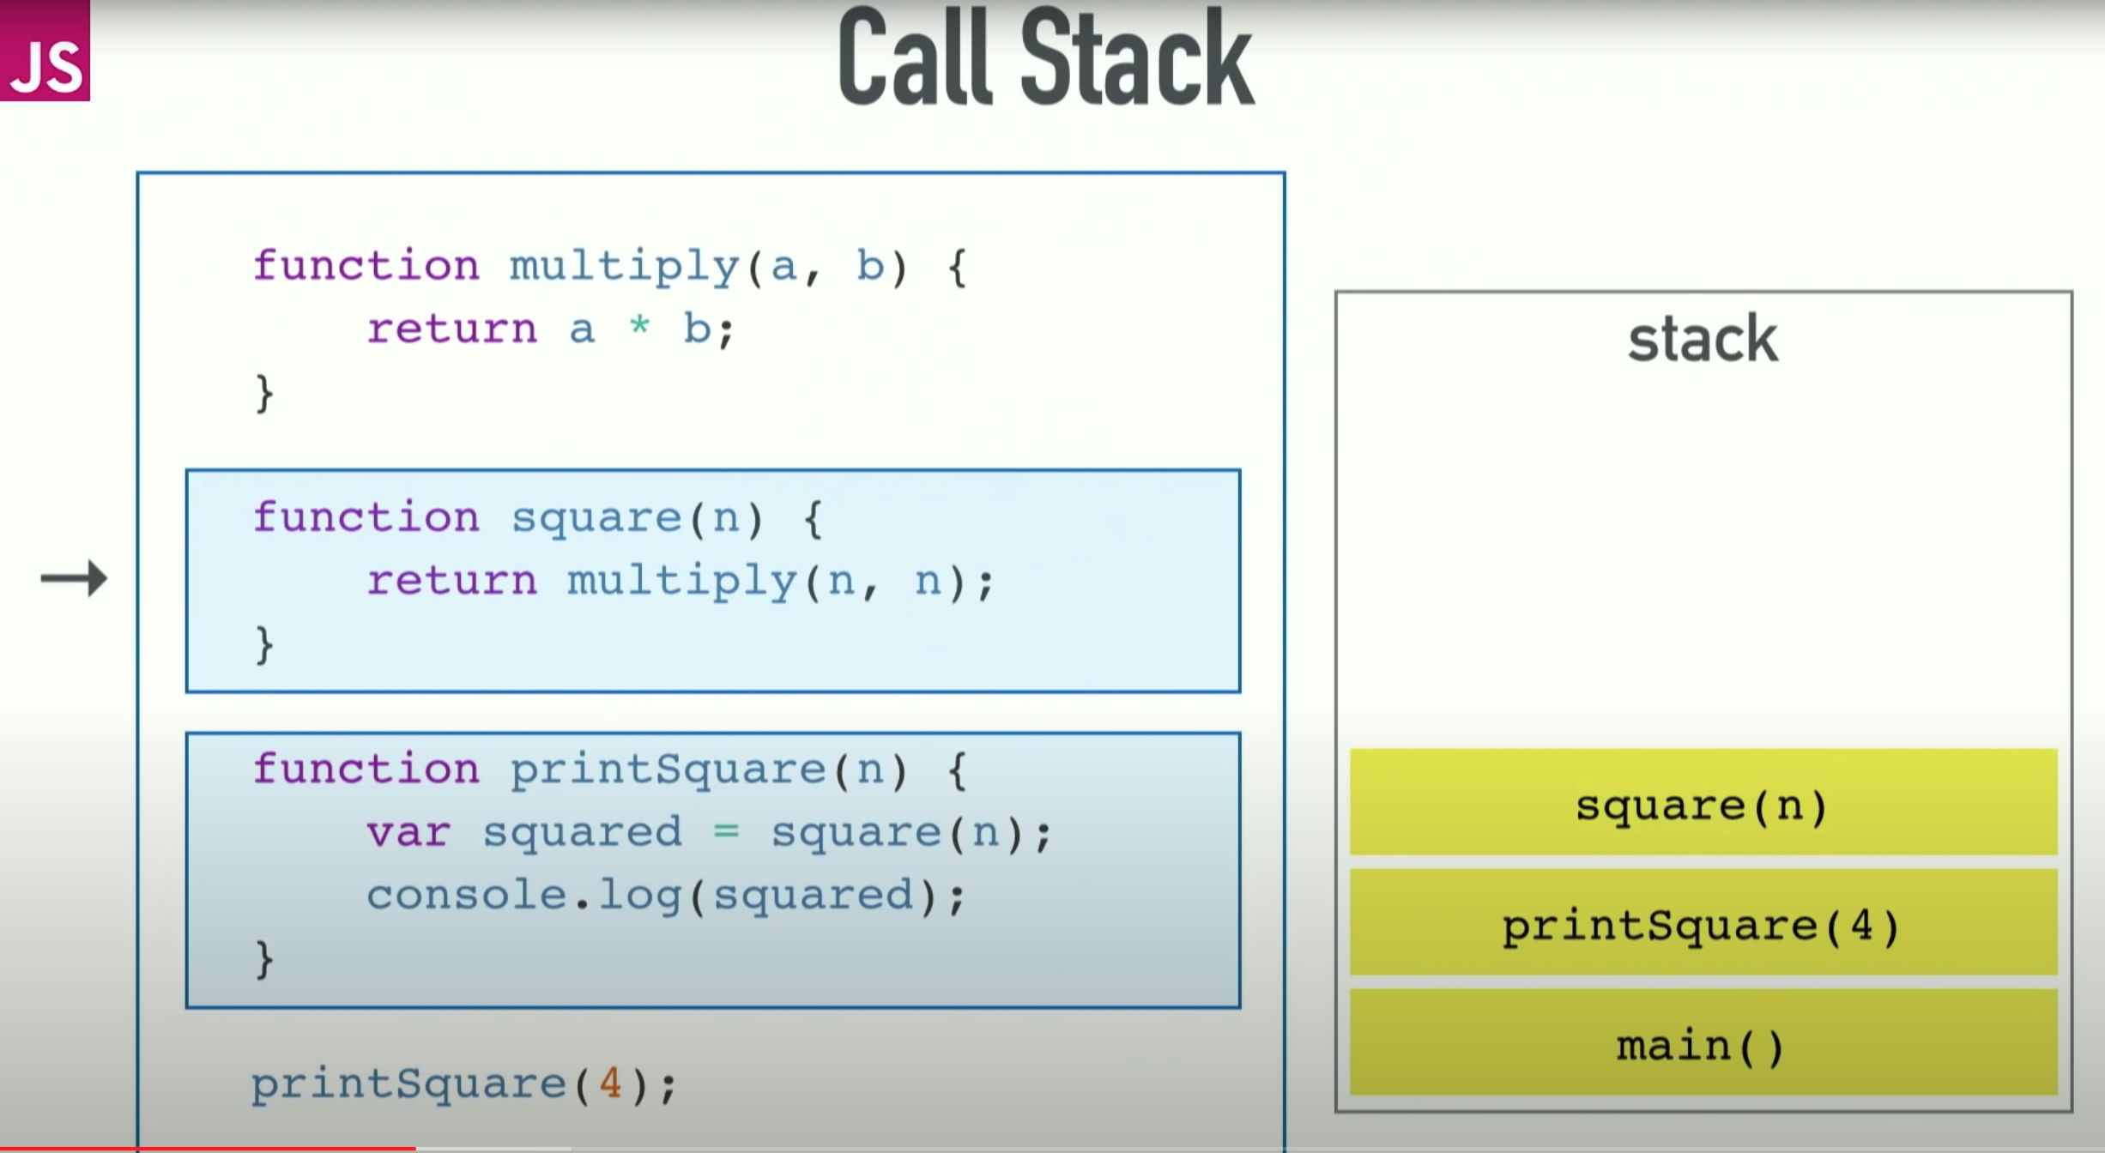
Call Stack

Slide 15
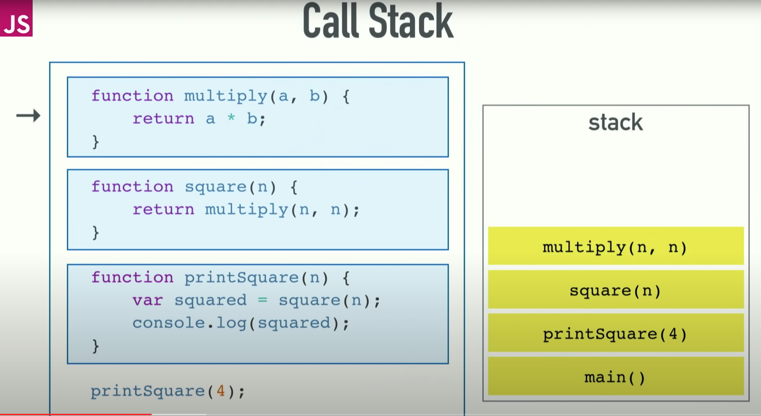
Call Stack

Slide 16
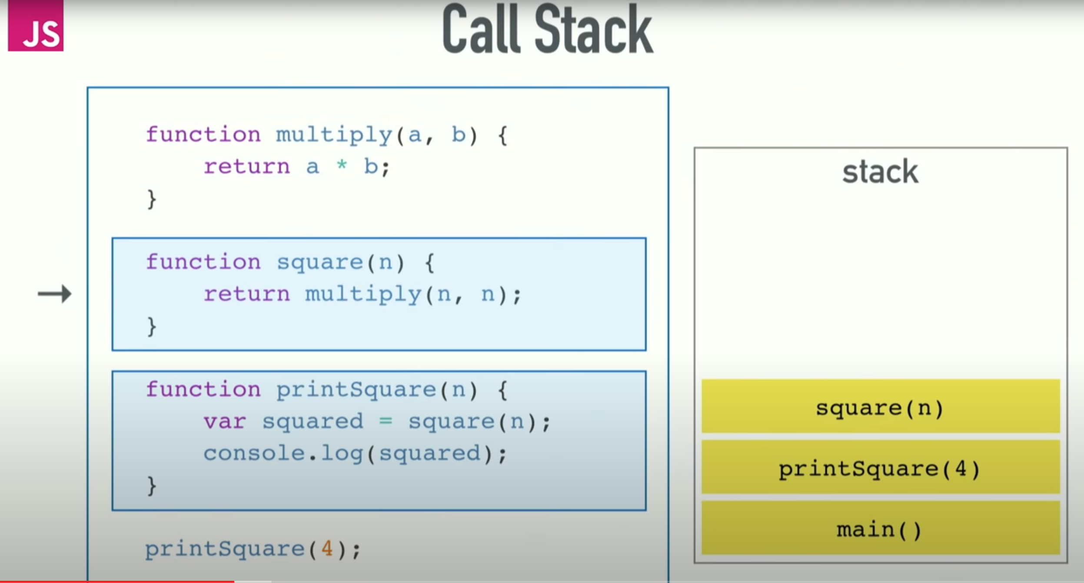
Call Stack

Slide 17
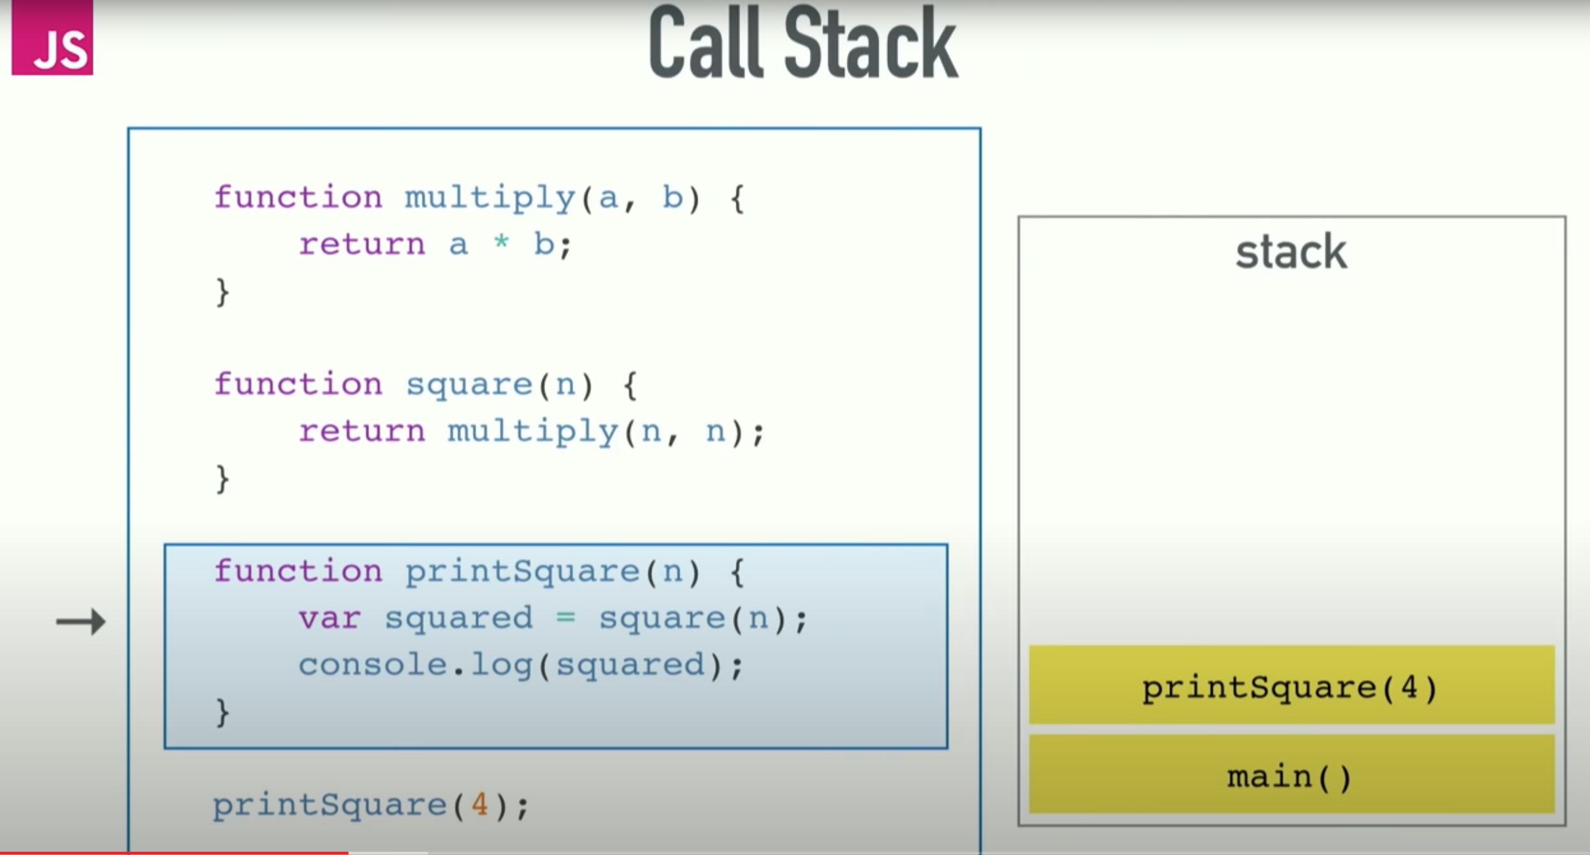
Call Stack

Slide 18
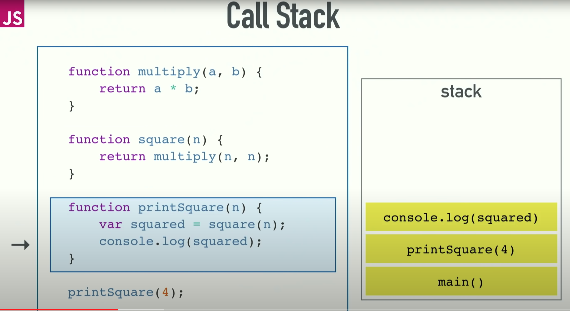
Call Stack

Slide 19
Call Stack

Slide 20
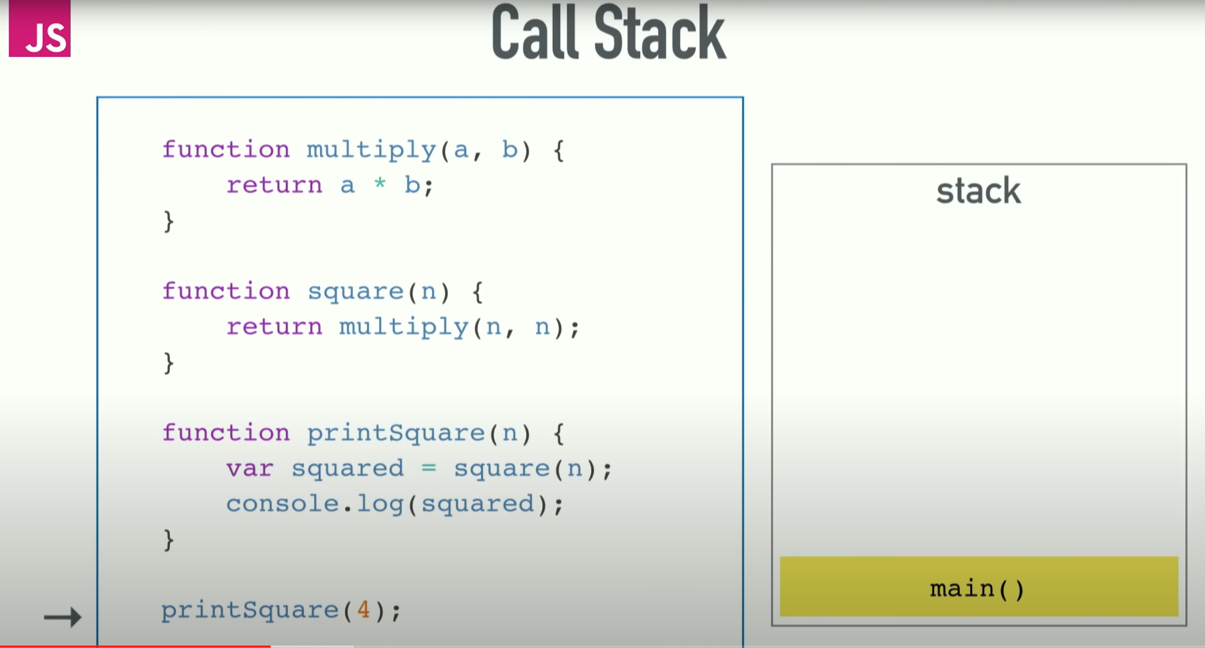
Call Stack

Slide 21
Call Stack

Slide 22
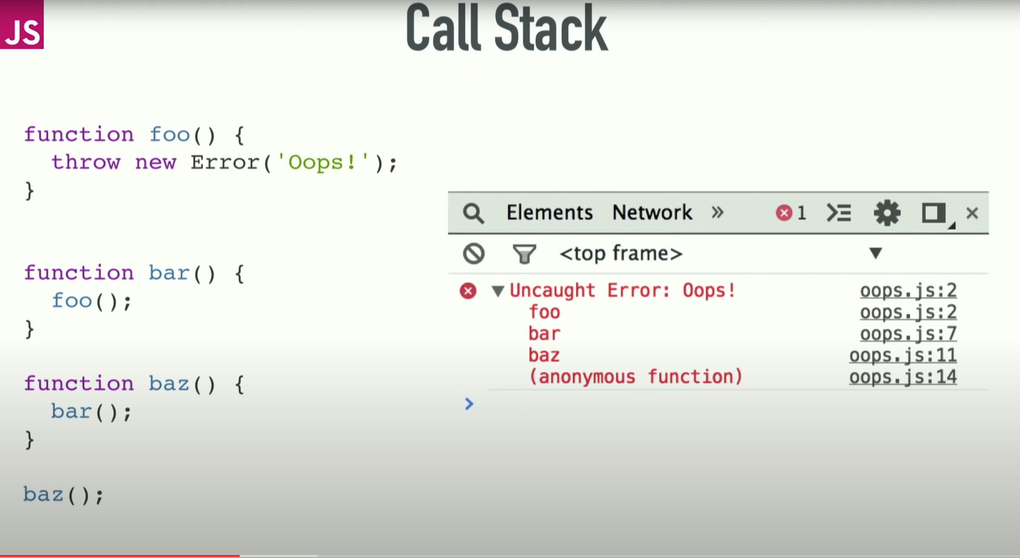
Call Stack
We can see the state of the call stack when we get error.
The browser prints the stack trace, which is the state of the stack when the error happened.

Slide 23
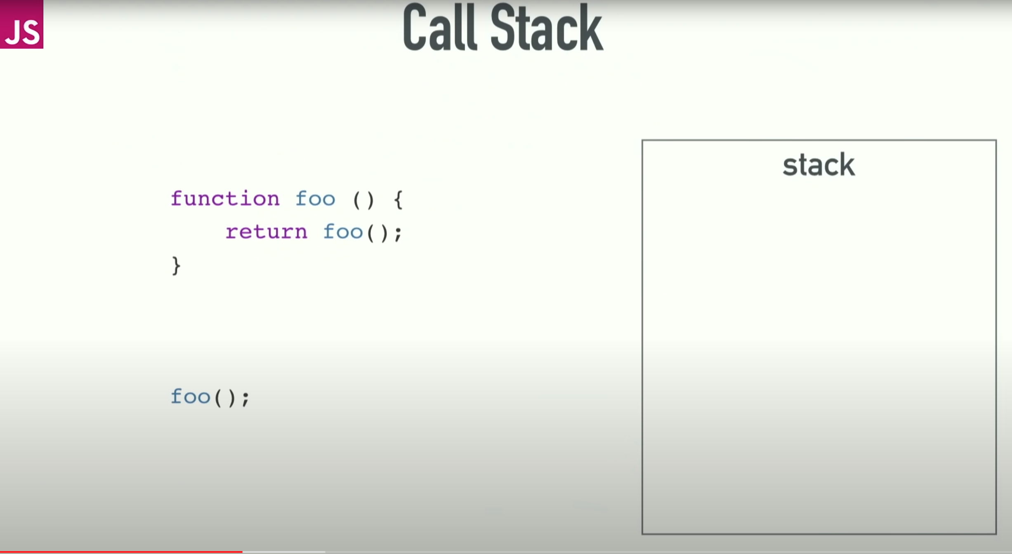
Call Stack
Blowing the stack.

Slide 24
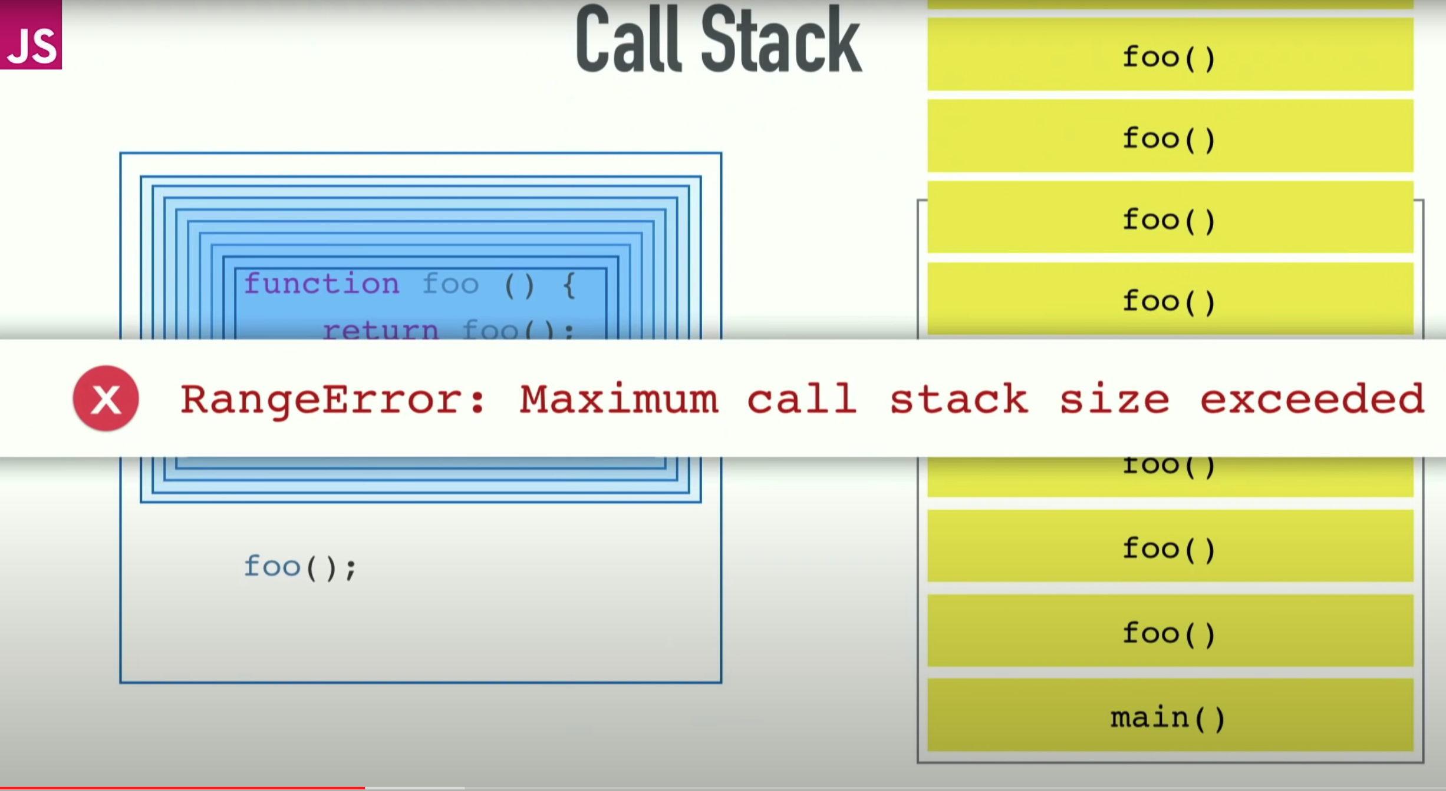
Call Stack

Slide 25
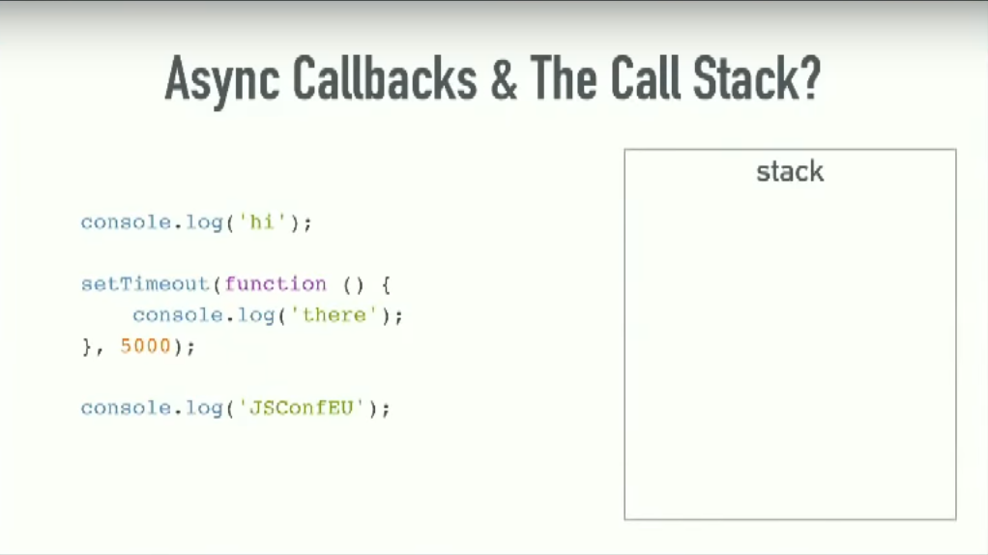
Async Callbacks

Slide 26
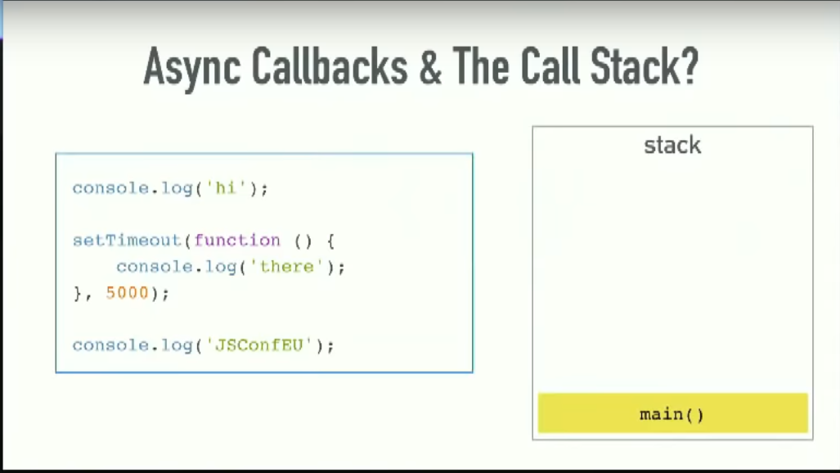
Async Callbacks

Slide 27
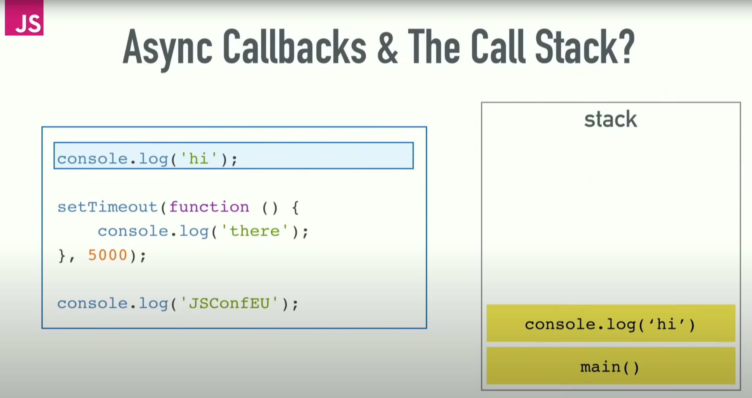
Async Callbacks

Slide 28
Async Callbacks

Slide 29
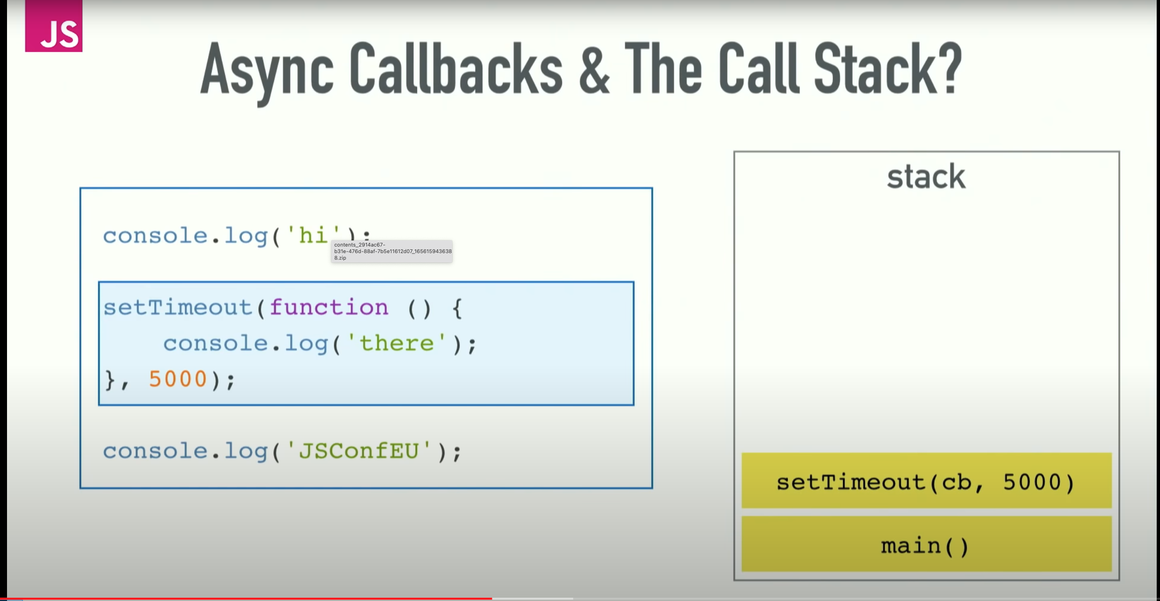
Async Callbacks

Slide 30
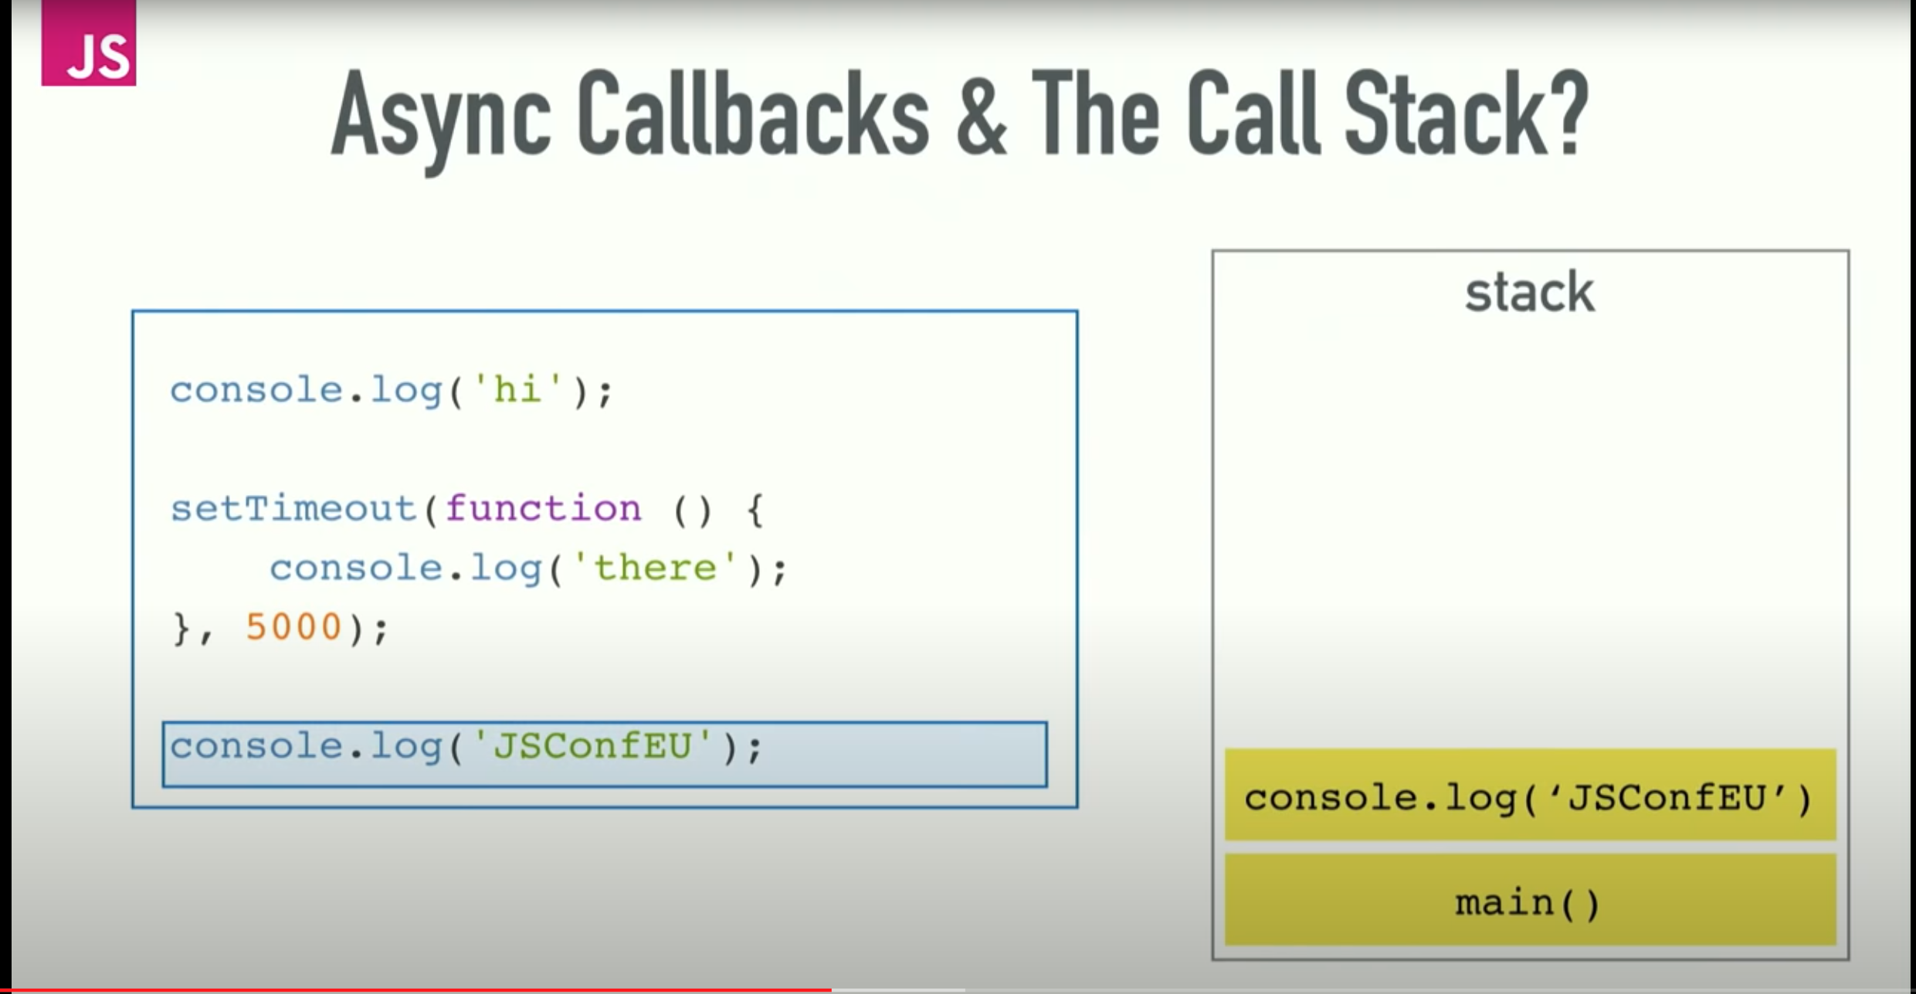
Async Callbacks

Slide 31
Async Callbacks

Slide 32
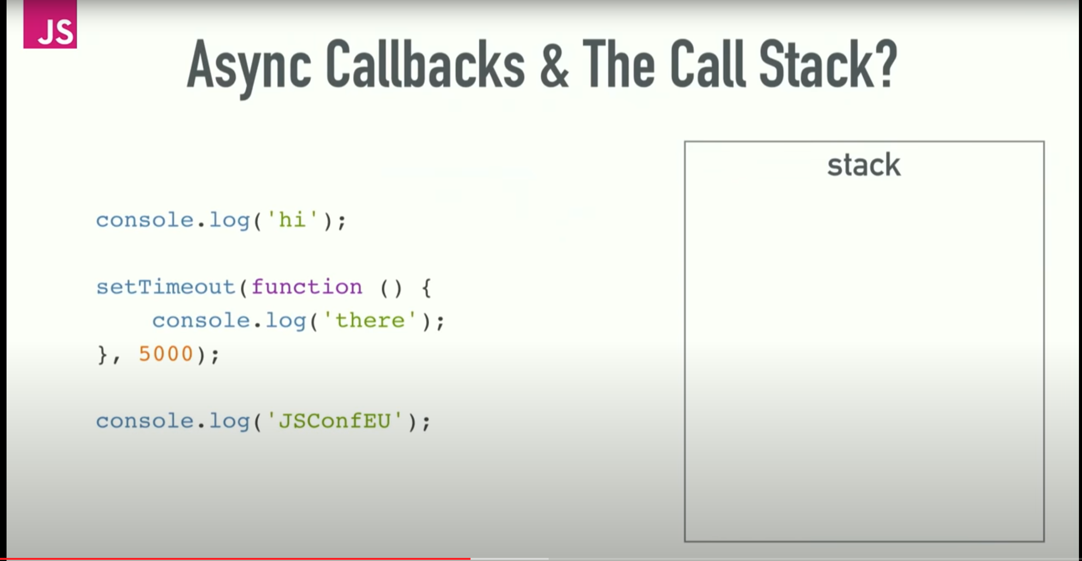
Async Callbacks

Slide 33
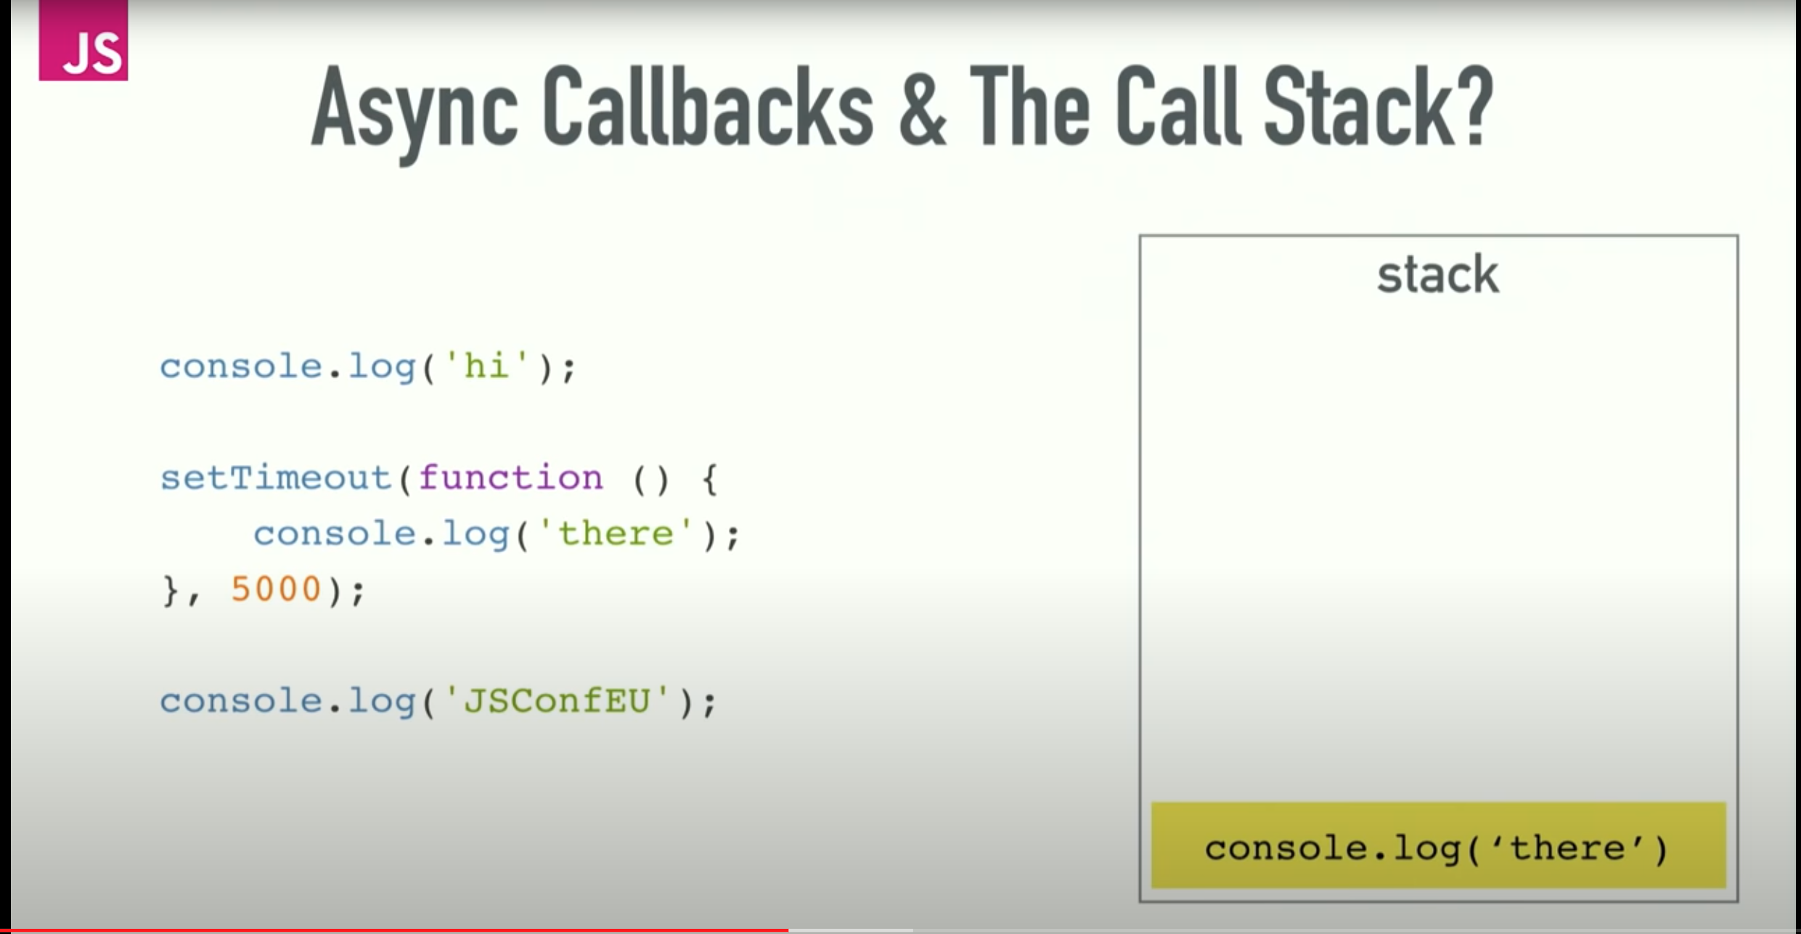
Async Callbacks

Slide 34
Async Callbacks

Slide 35
Event Loop
The event loop comes in on concurrency.
JavaScript Runtime can only do one thing at one time. It can't make an AJAX request while you're doing other code. It can't do a setTimeout while you're doing another code.
The reason we can do things concurrently is that the runtime included tools that can help us.
The browser gives us Web APIs, these are effectively threads, you can just make calls to, and those pieces of the browser are aware of this concurrency kicks in.
The same for node.js, instead of web APIs we have C++ APIs and the threading is being hidden from you by C++

Slide 36
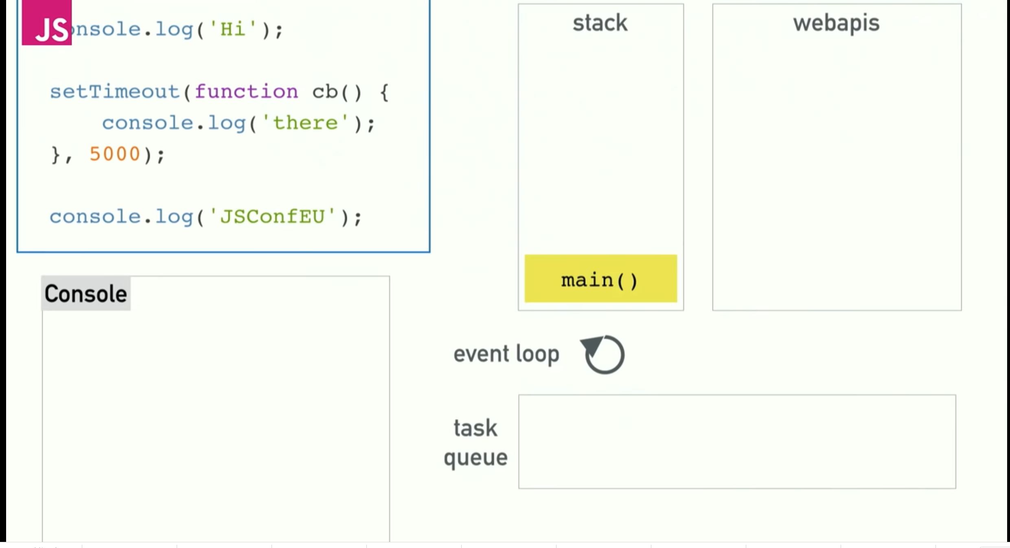
Event Loop

Slide 37
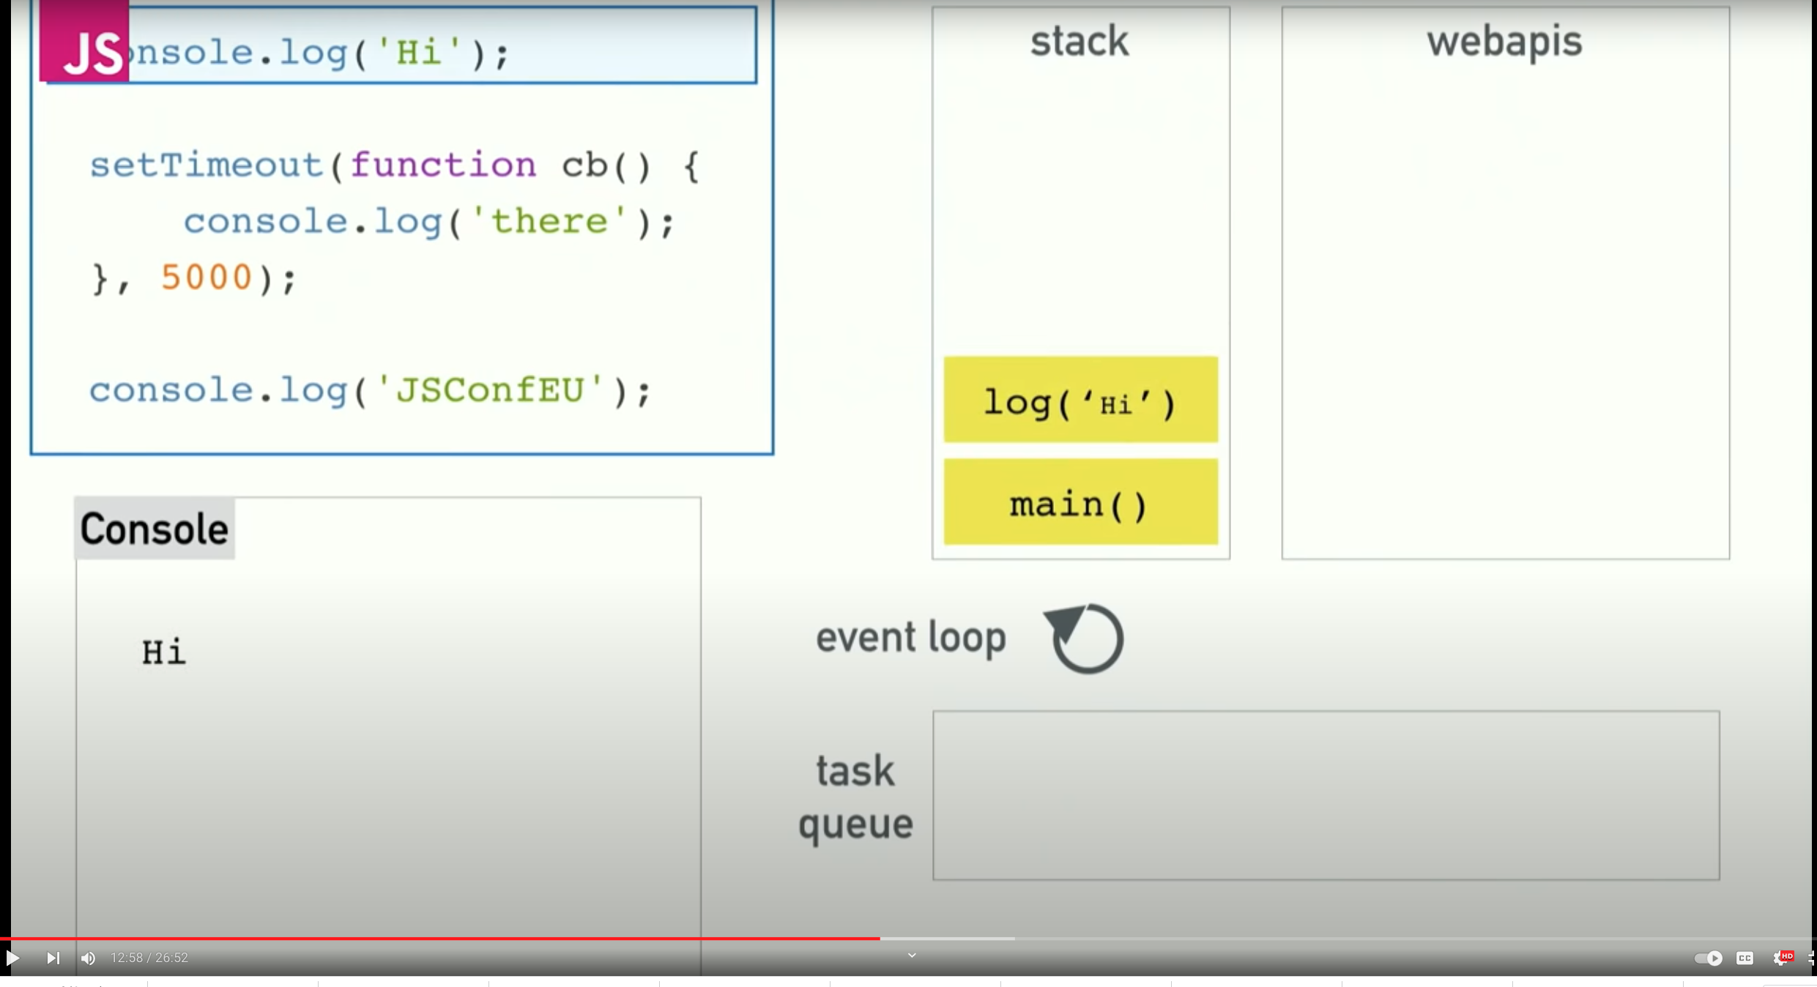
Event Loop

Slide 38
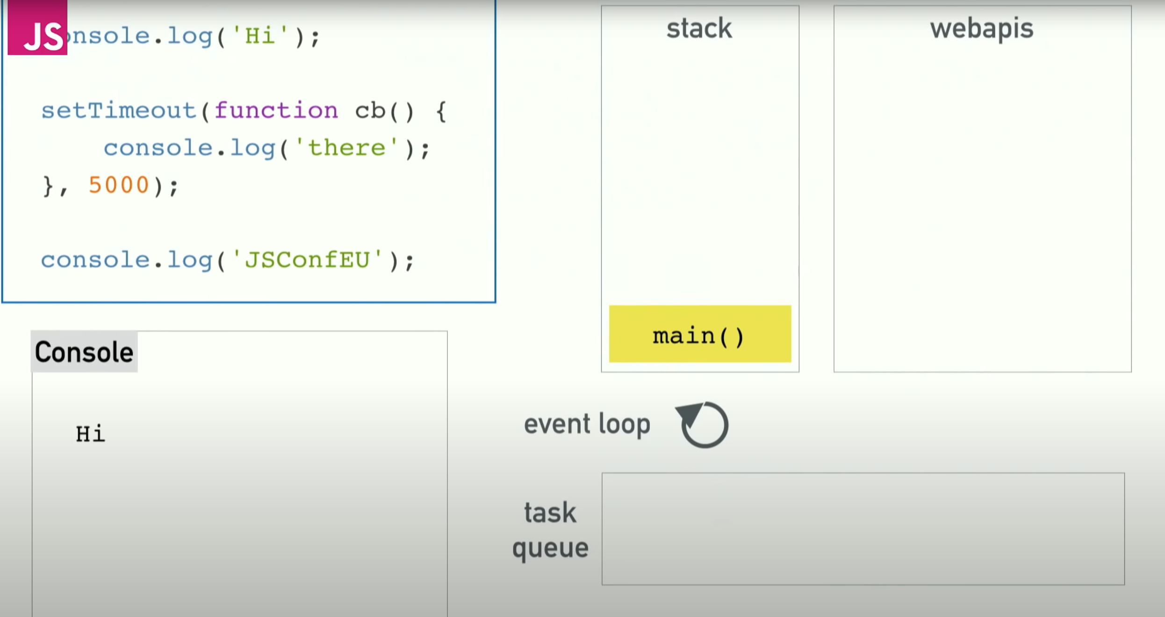
Event Loop

Slide 39
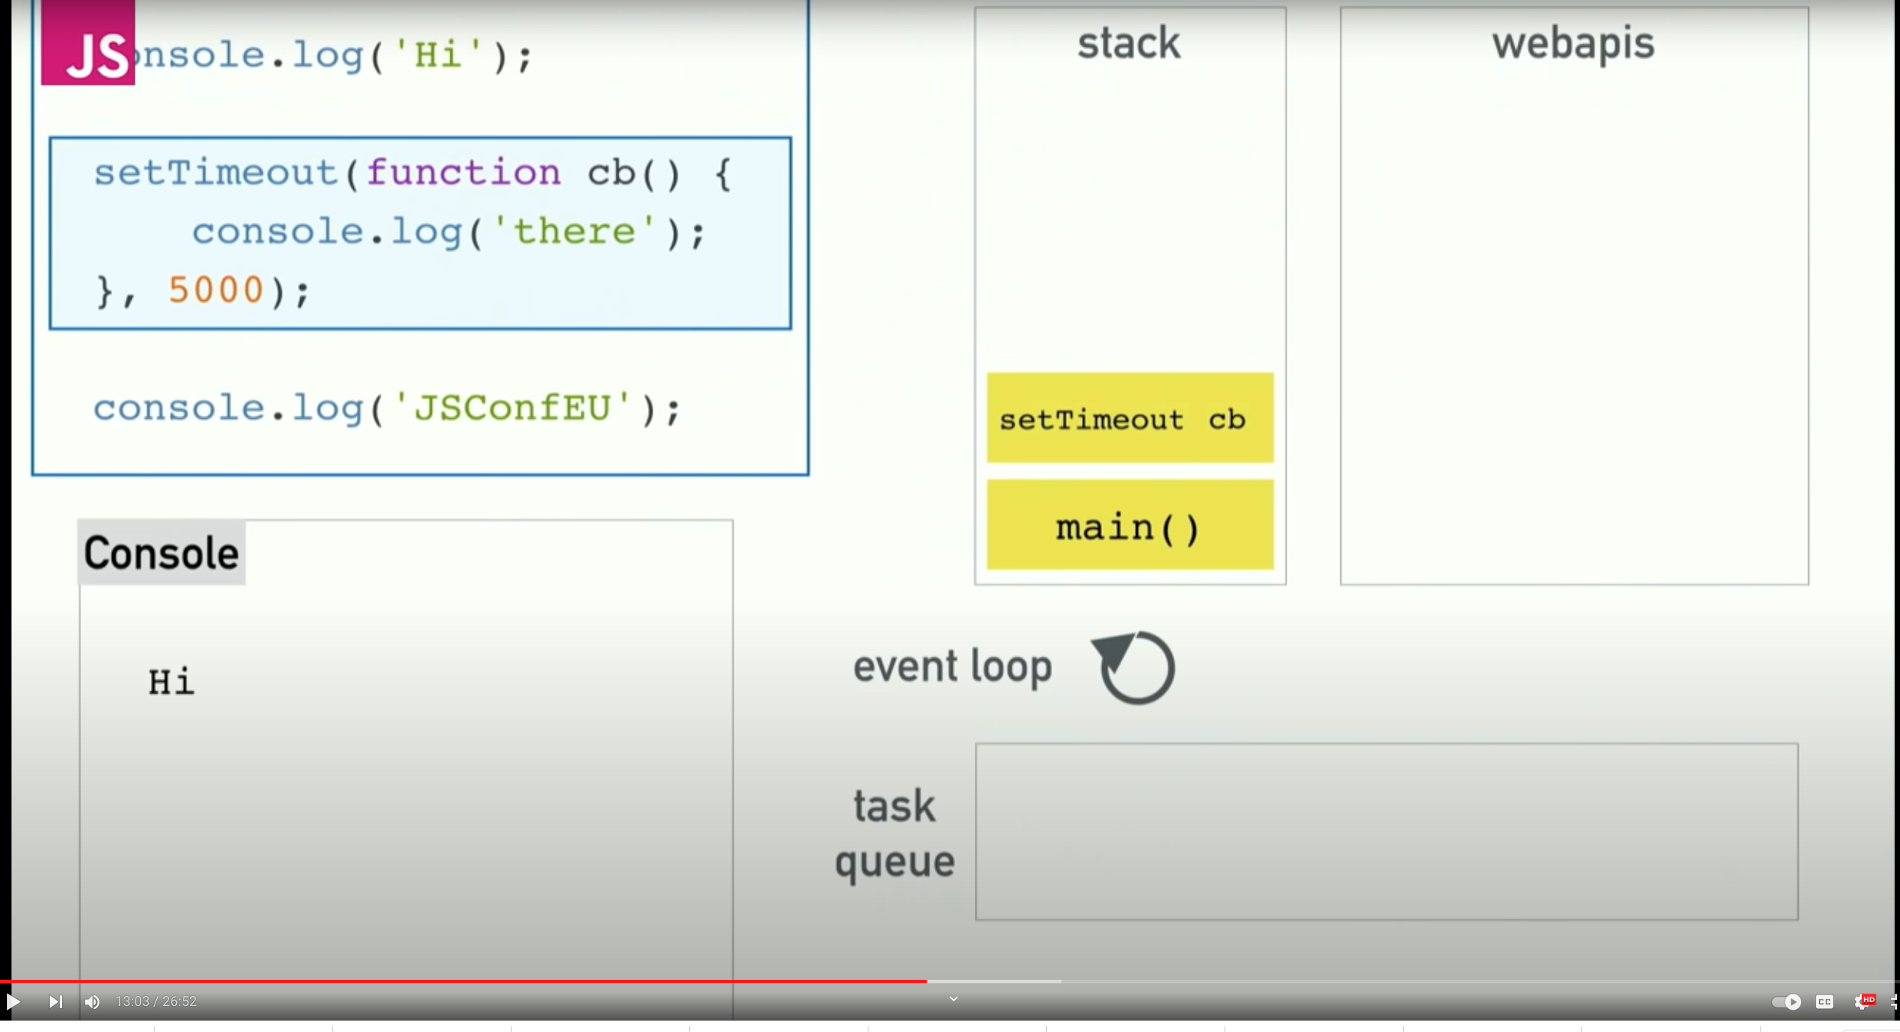
Event Loop

Slide 40
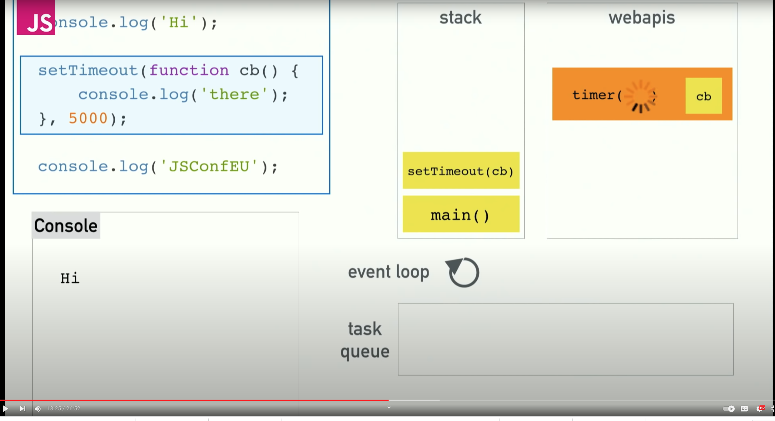
Event Loop
setTimeout is an API that doesn't live in the V8 source but provided to us by the browser. The browser kicks off a timer. And it handles the count down.

Slide 41
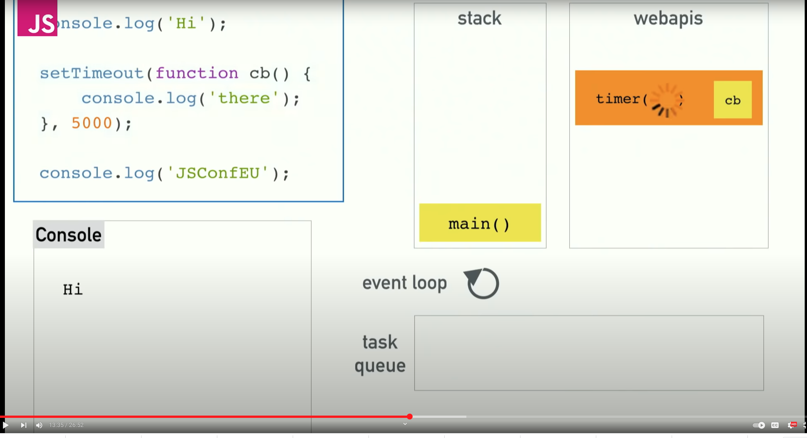
Event Loop
Because the browser take the responsibility on the timer, the setTimeout call itself is complete, so we can pop off the stack.

Slide 42
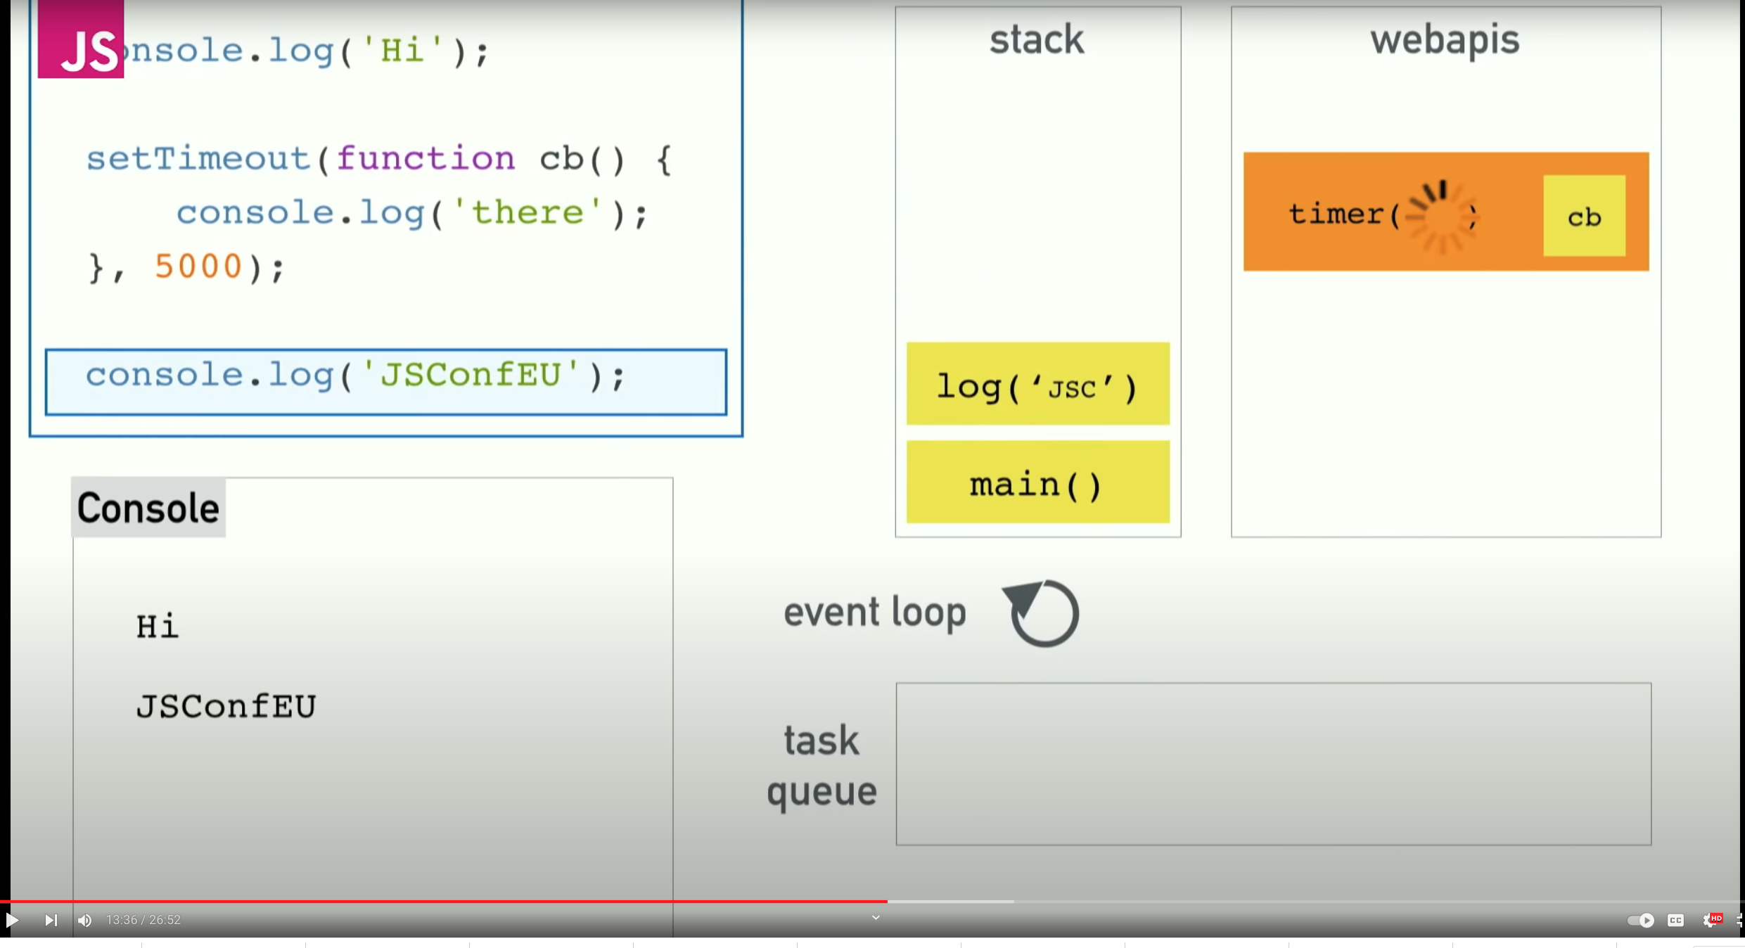
Event Loop

Slide 43
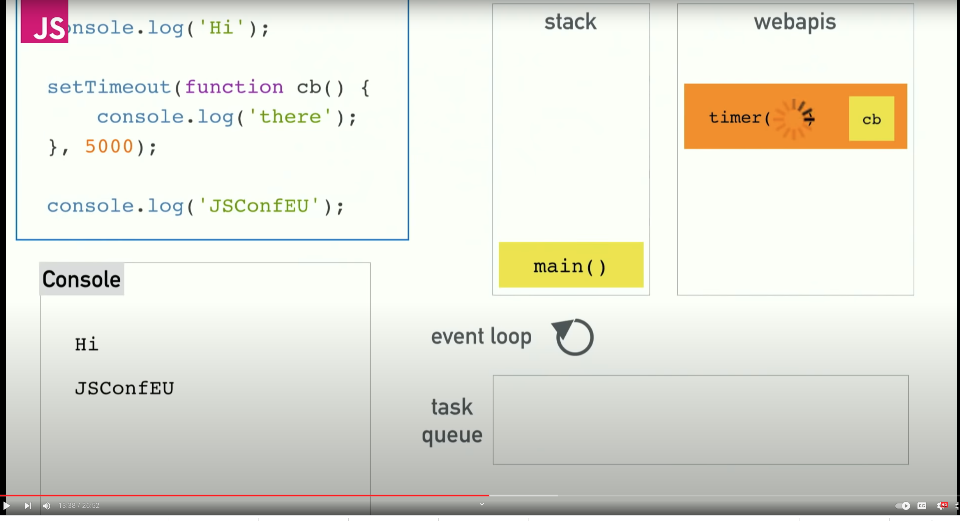
Event Loop

Slide 44
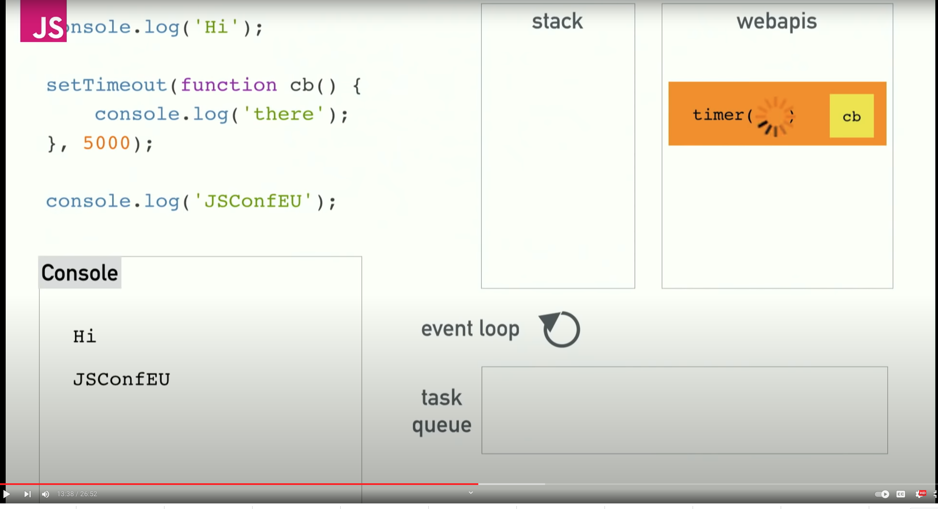
Event Loop

Slide 45
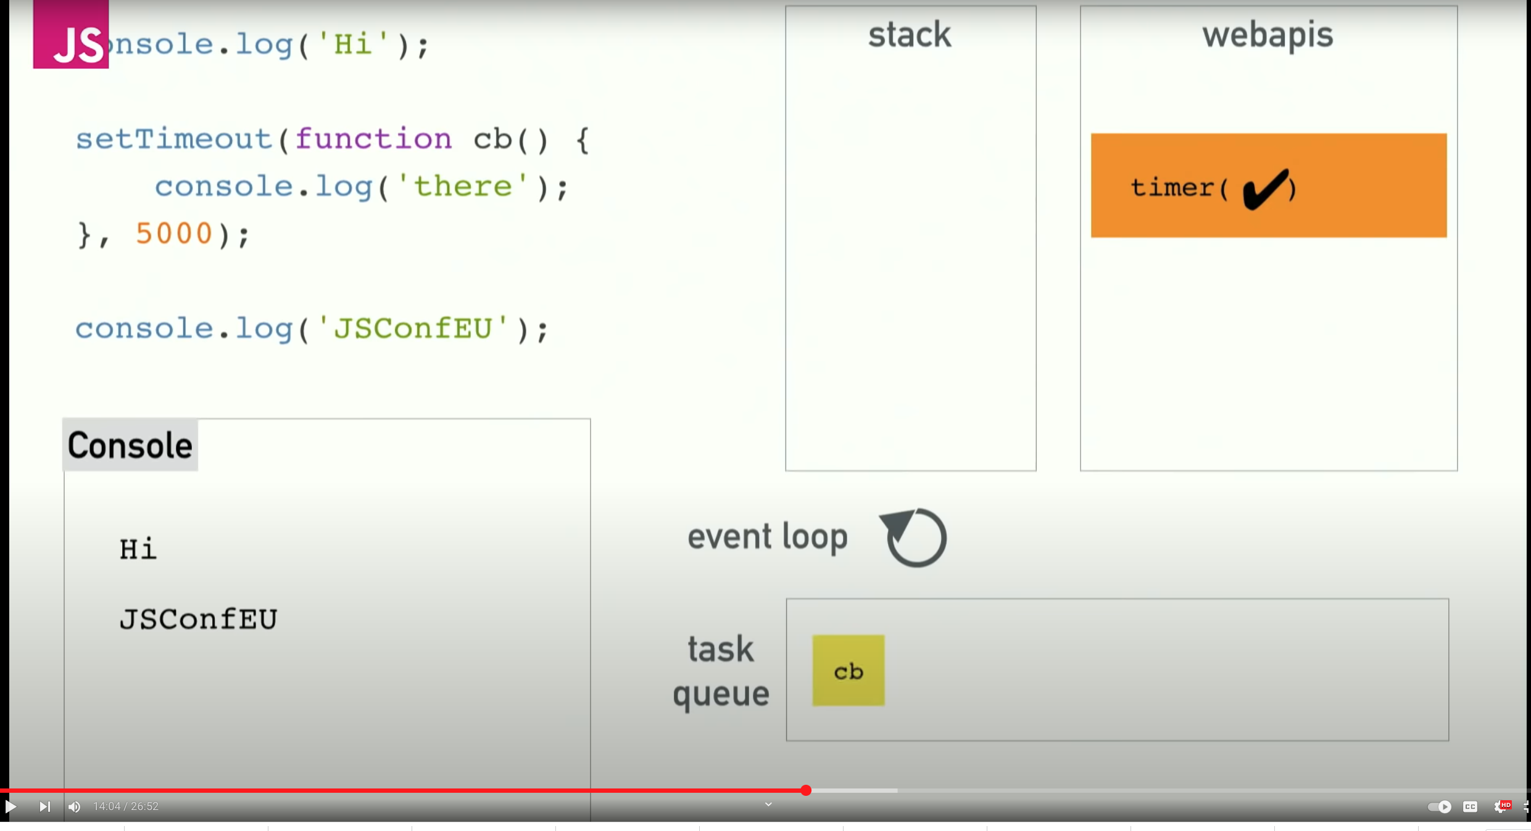
Event Loop
Five seconds later the timer going to complete.
The web API can't chuck stuff onto the stack when it's ready. if it did, it would appear randomly in the middle of your code.
The web APIs pushes the callback on to the task queue when it's done.

Slide 46
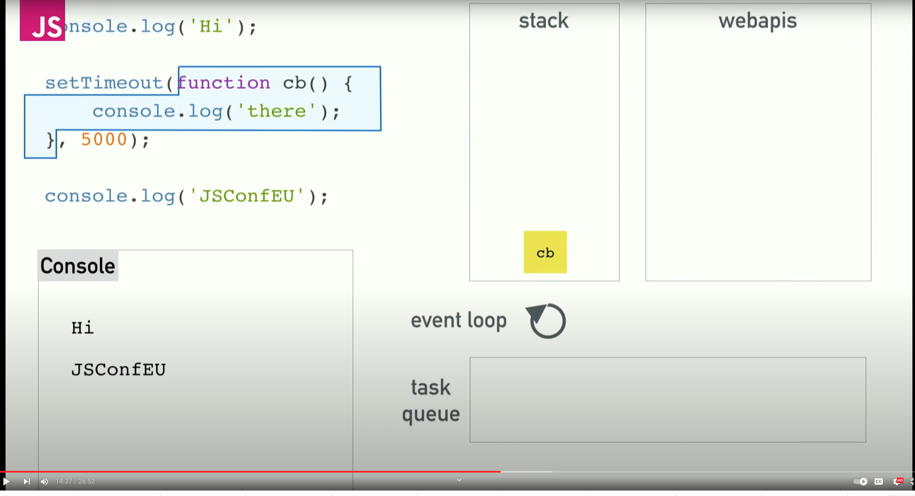
Event Loop
The event loop's job is to look at the stack and look at the task queue. If the stack is empty it takes the first thing on the queue and pushes it on to the stack which effectively run it.

Slide 47
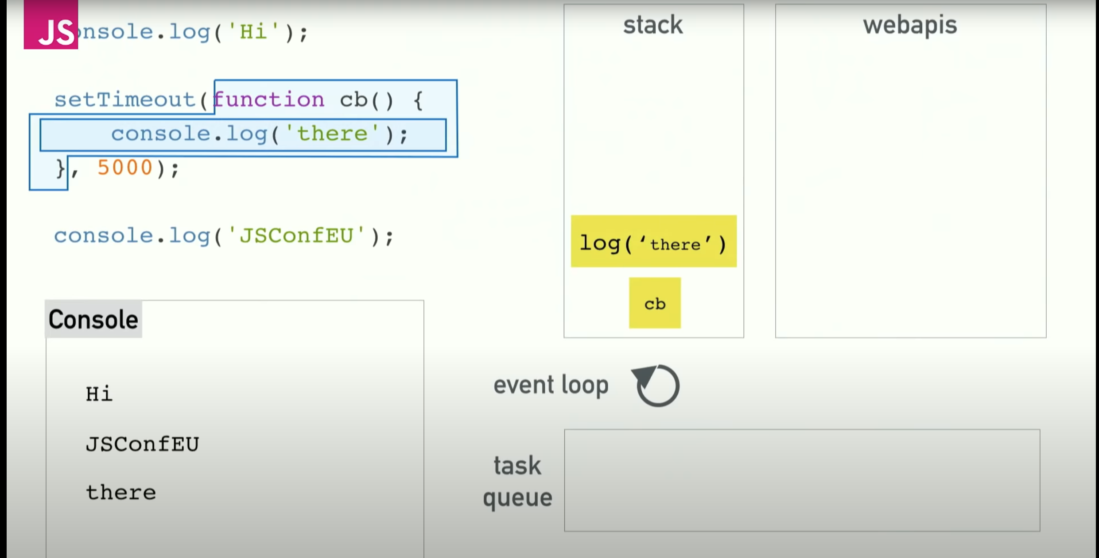
Event Loop

Slide 48
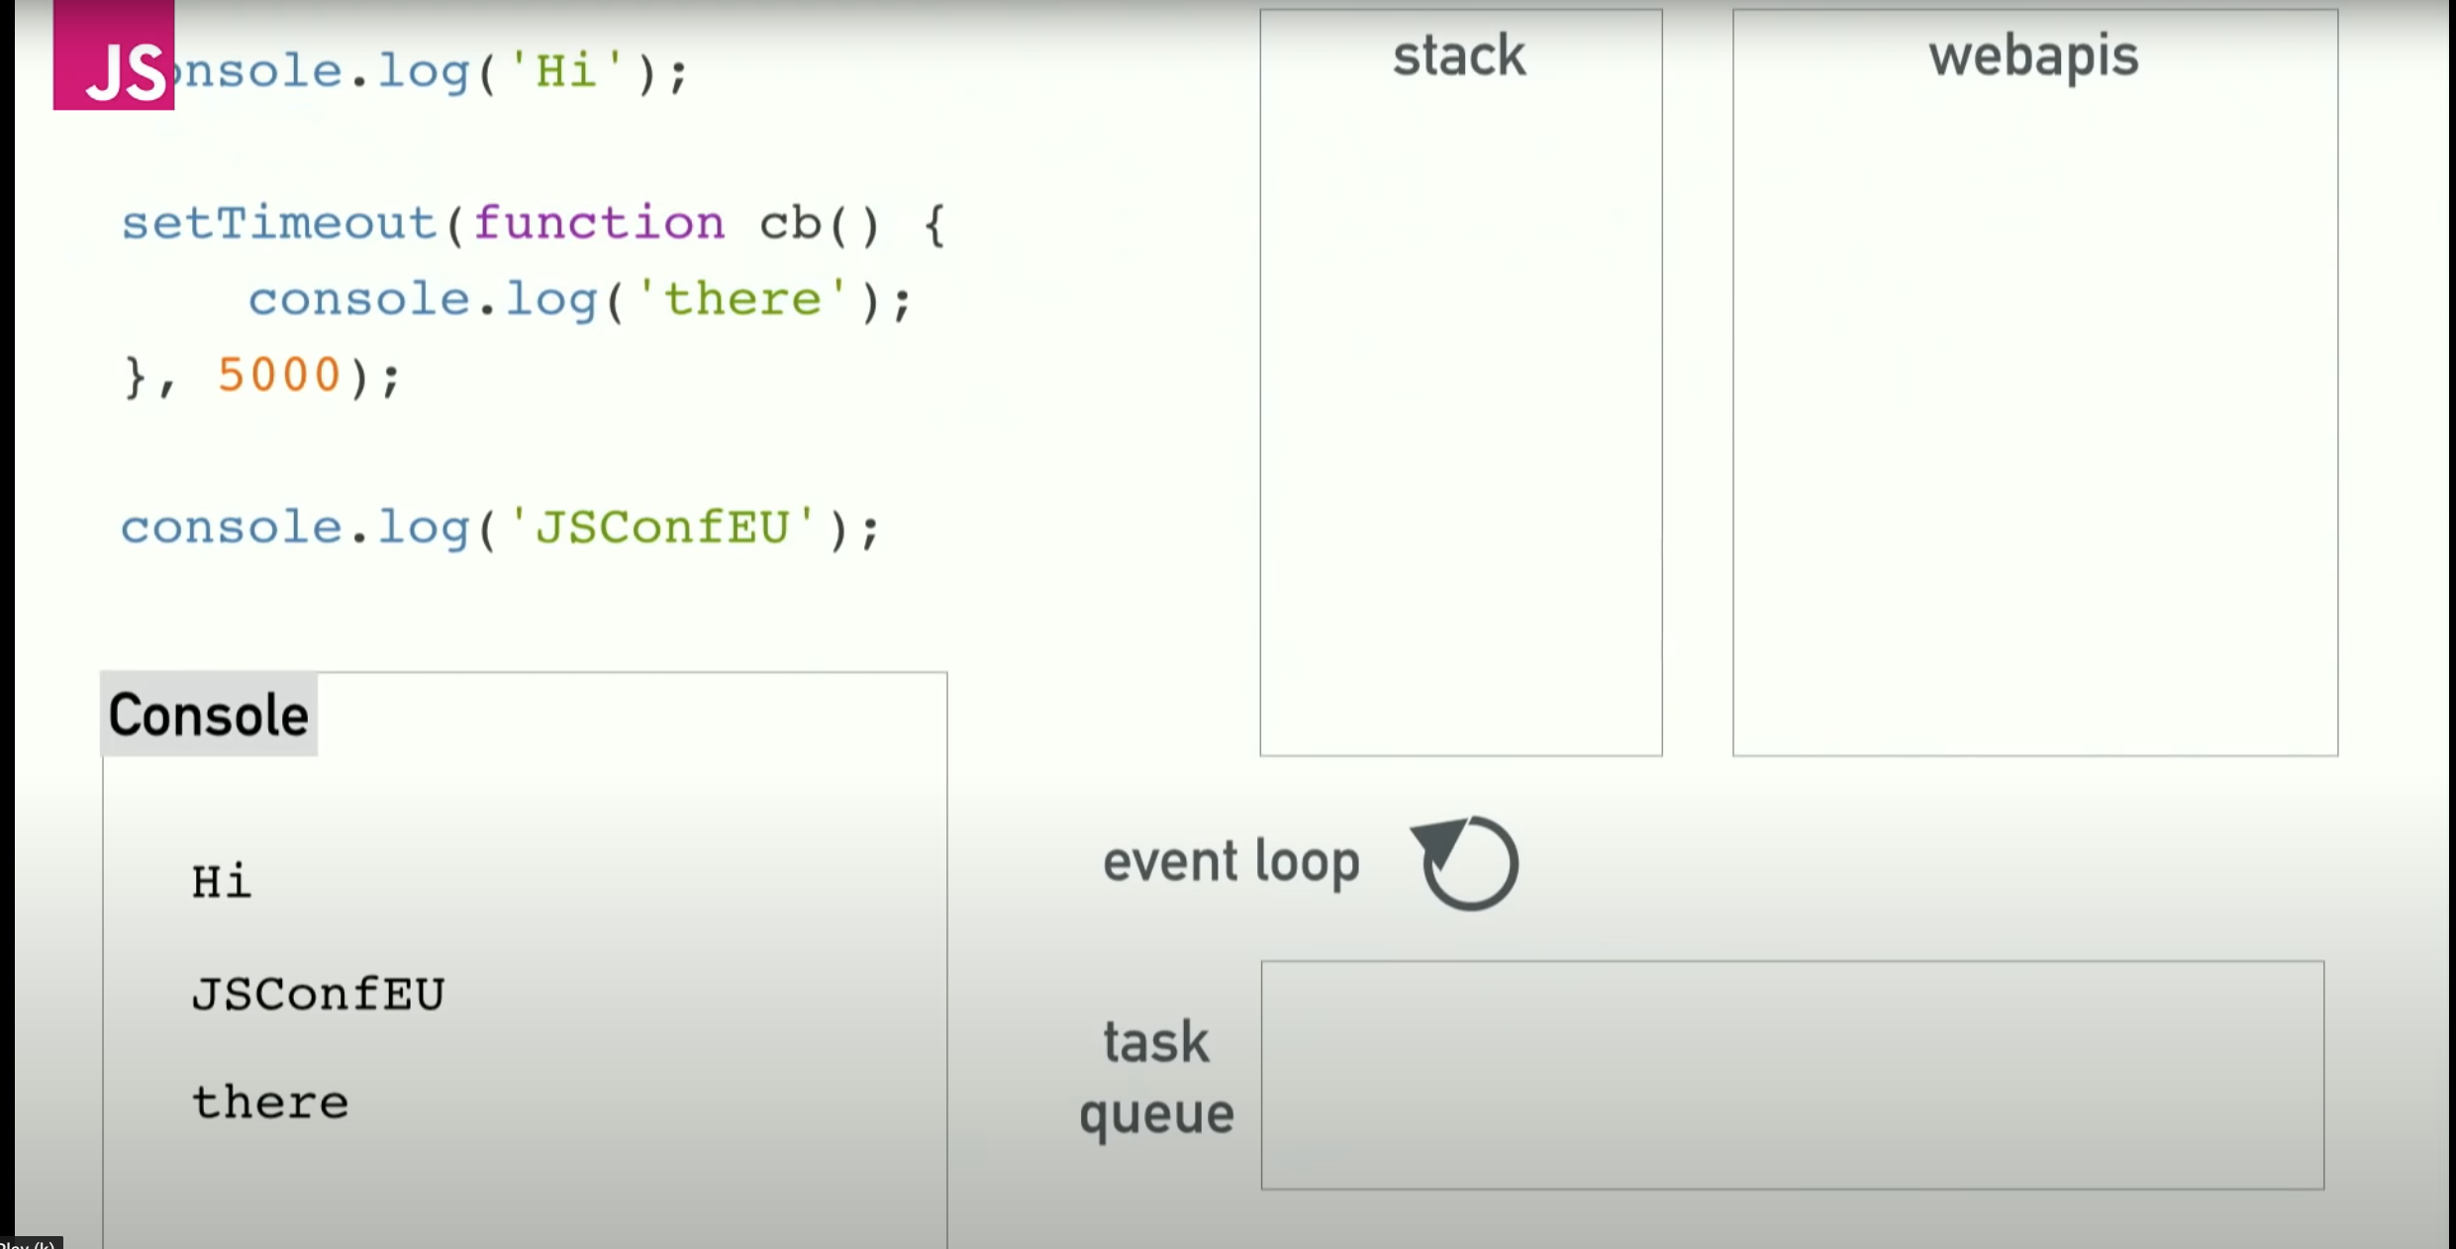
Event Loop

Slide 49
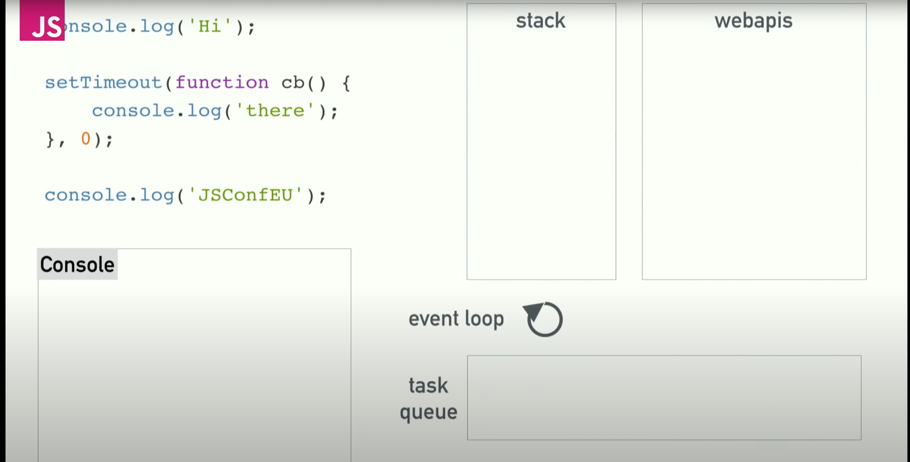
Event Loop – Another example
setTimeout is not a guaranteed time to execution, it's a minimum time to execution.
In this example we will see that setTimeout zero doesn't run the code immediately it runs the code a bit later.
This is because If the stack is not empty, the event loop waits until the stack will be empty and then it pushes to the stack.

Slide 50
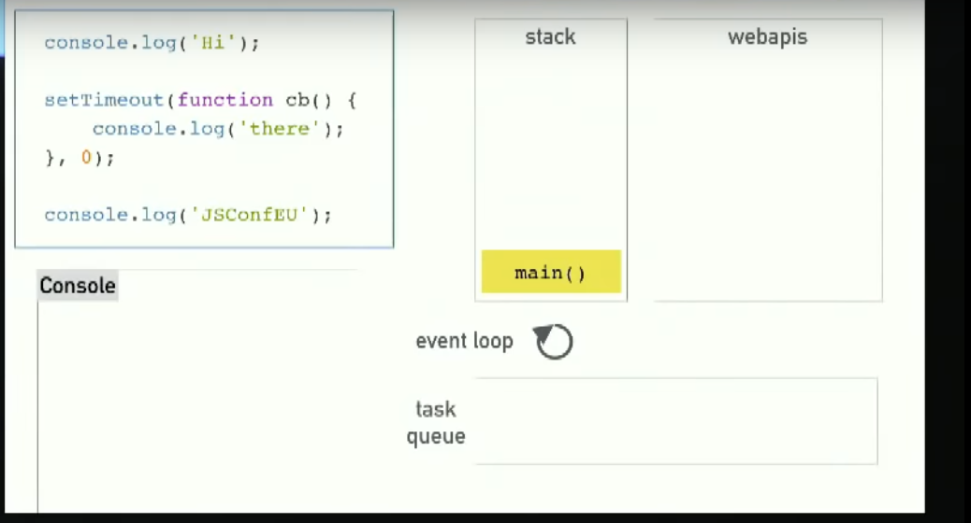
Event Loop

Slide 51
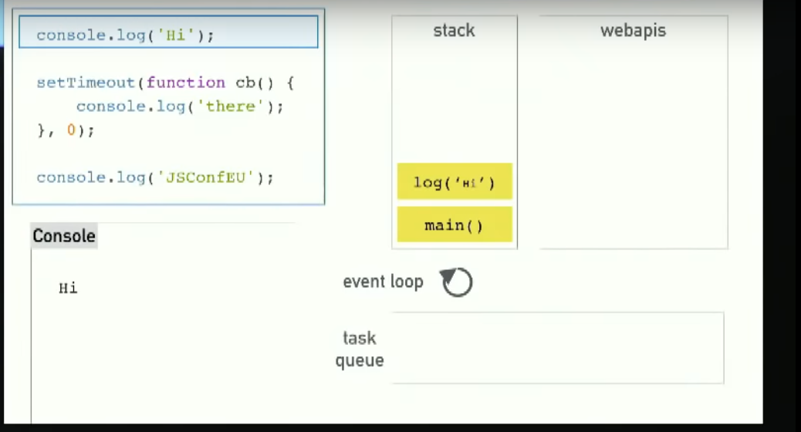
Event Loop

Slide 52
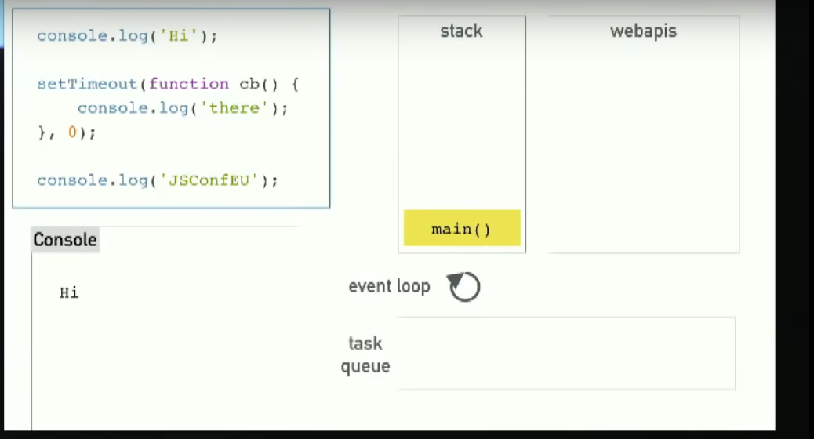
Event Loop

Slide 53
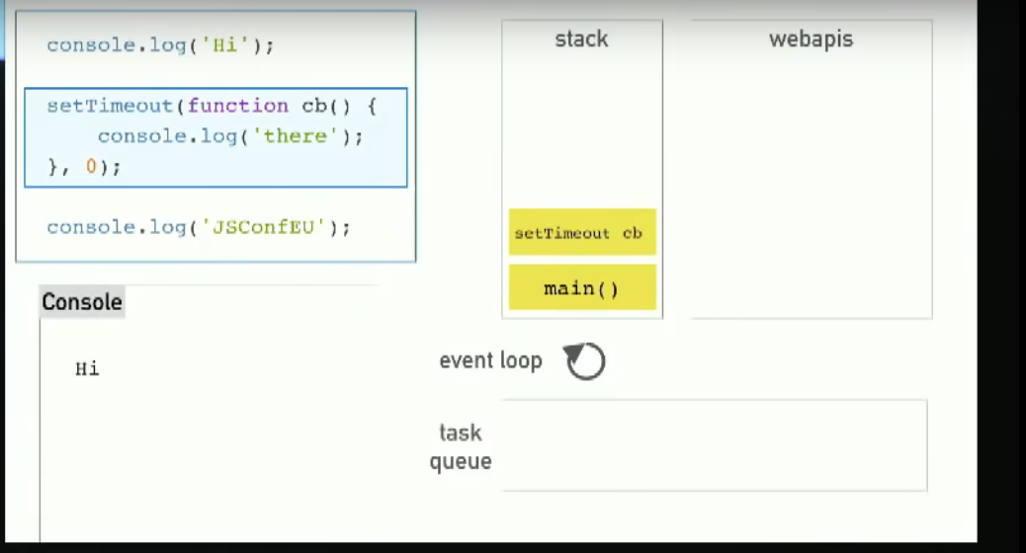
Event Loop

Slide 54
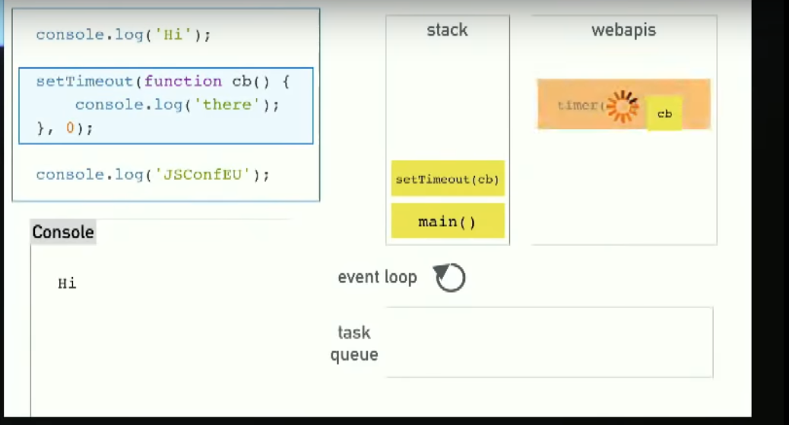
Event Loop

Slide 55
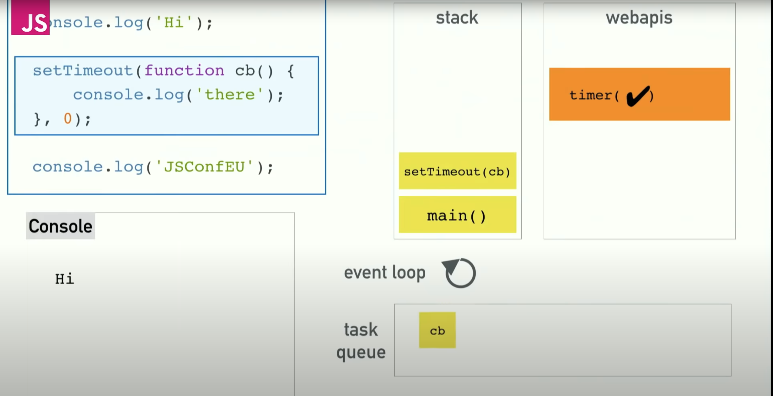
Event Loop

Slide 56
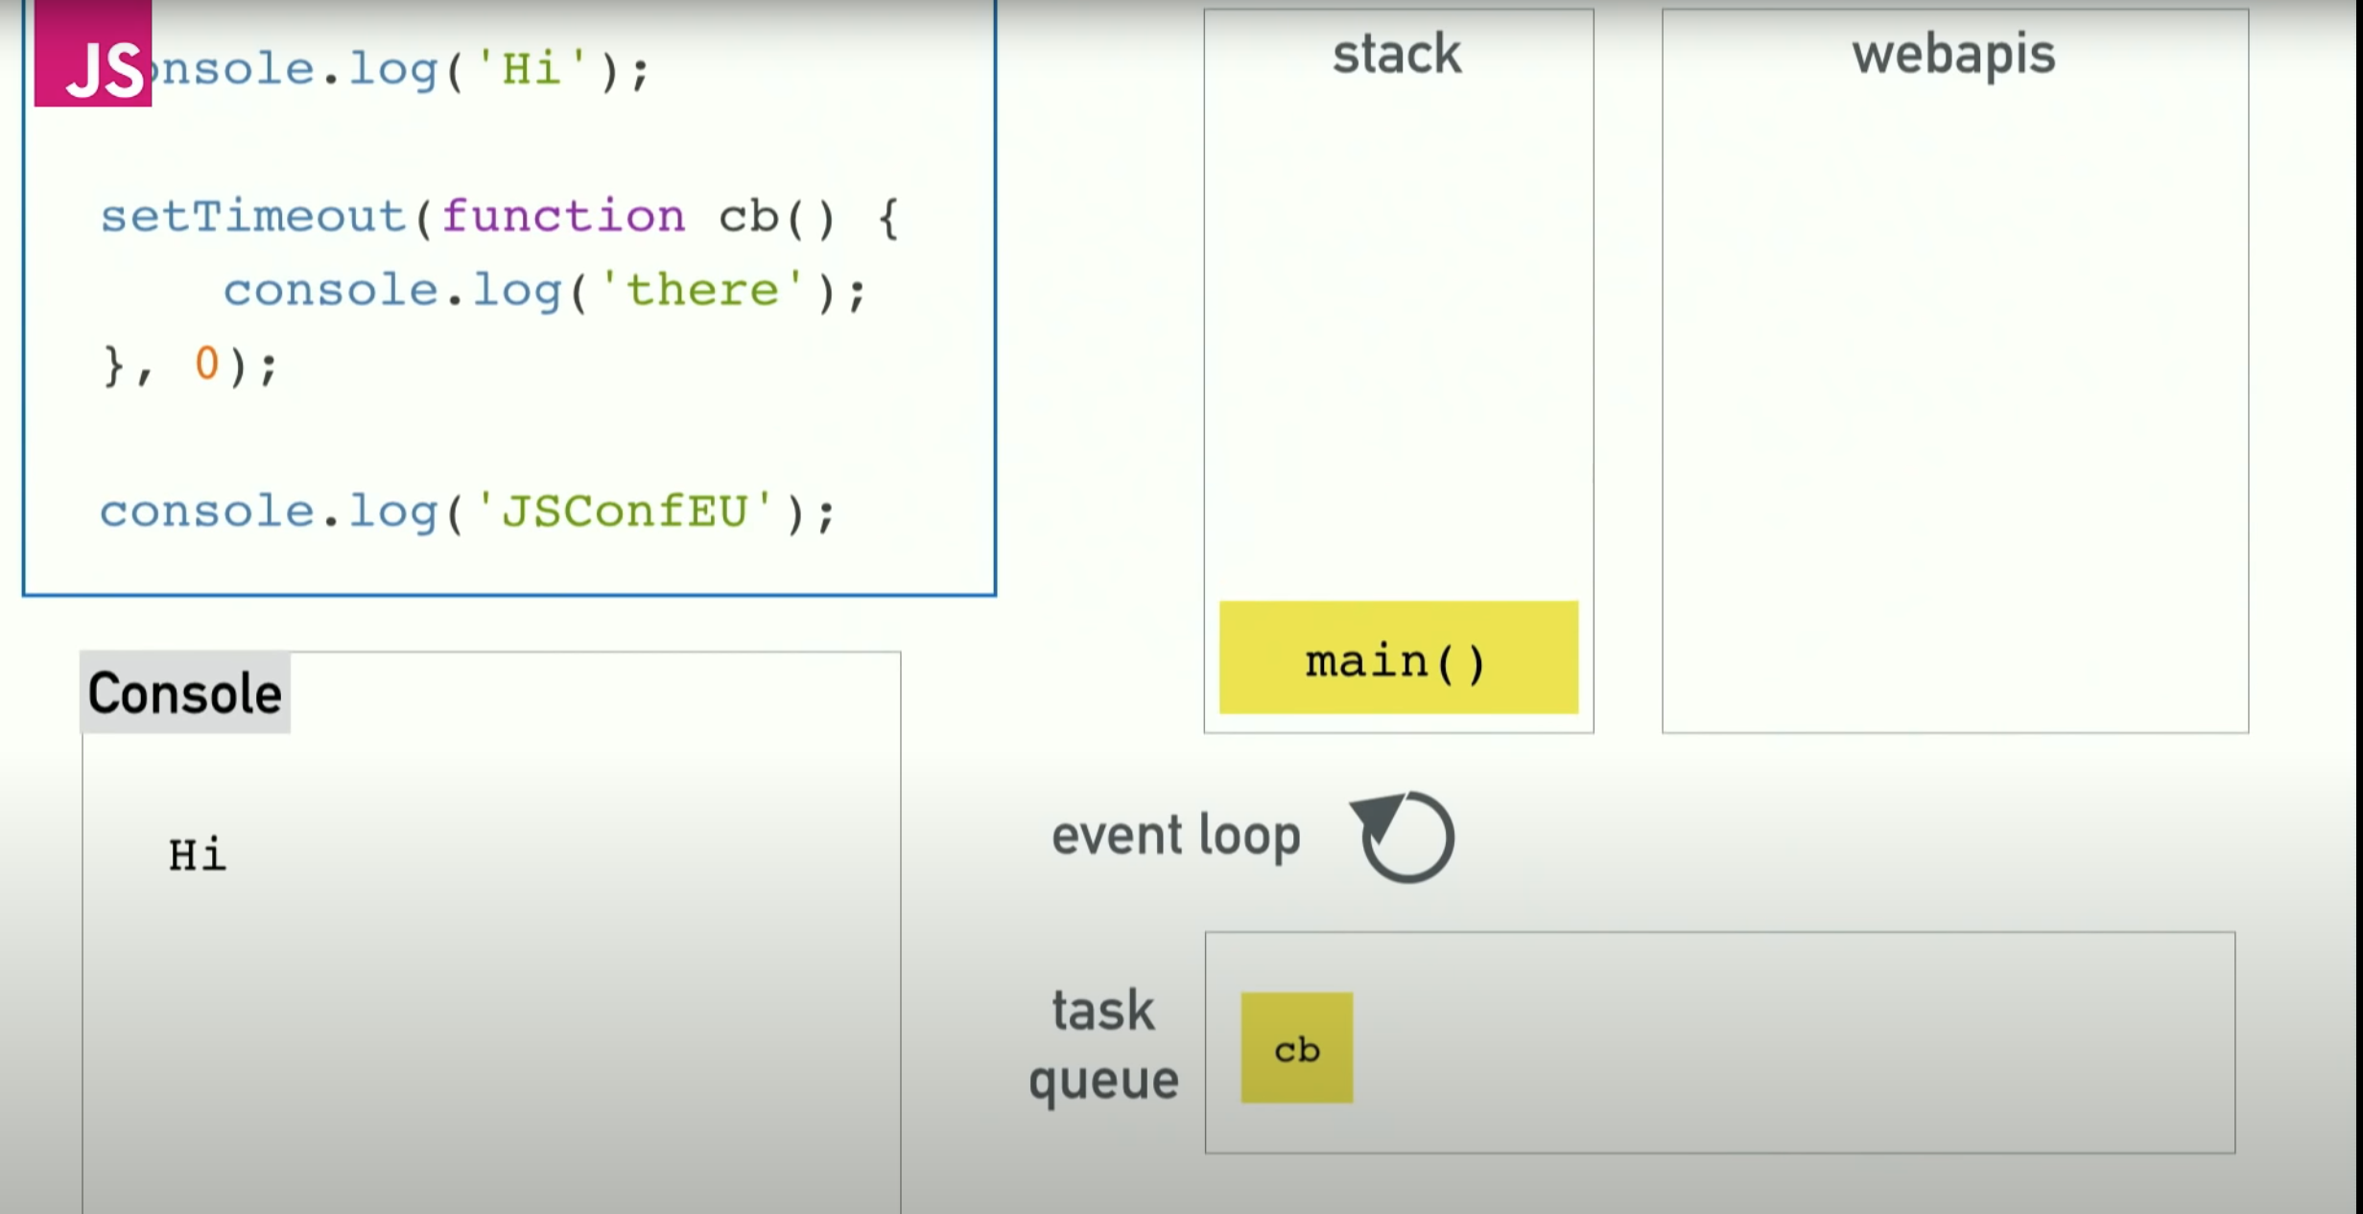
Event Loop

Slide 57
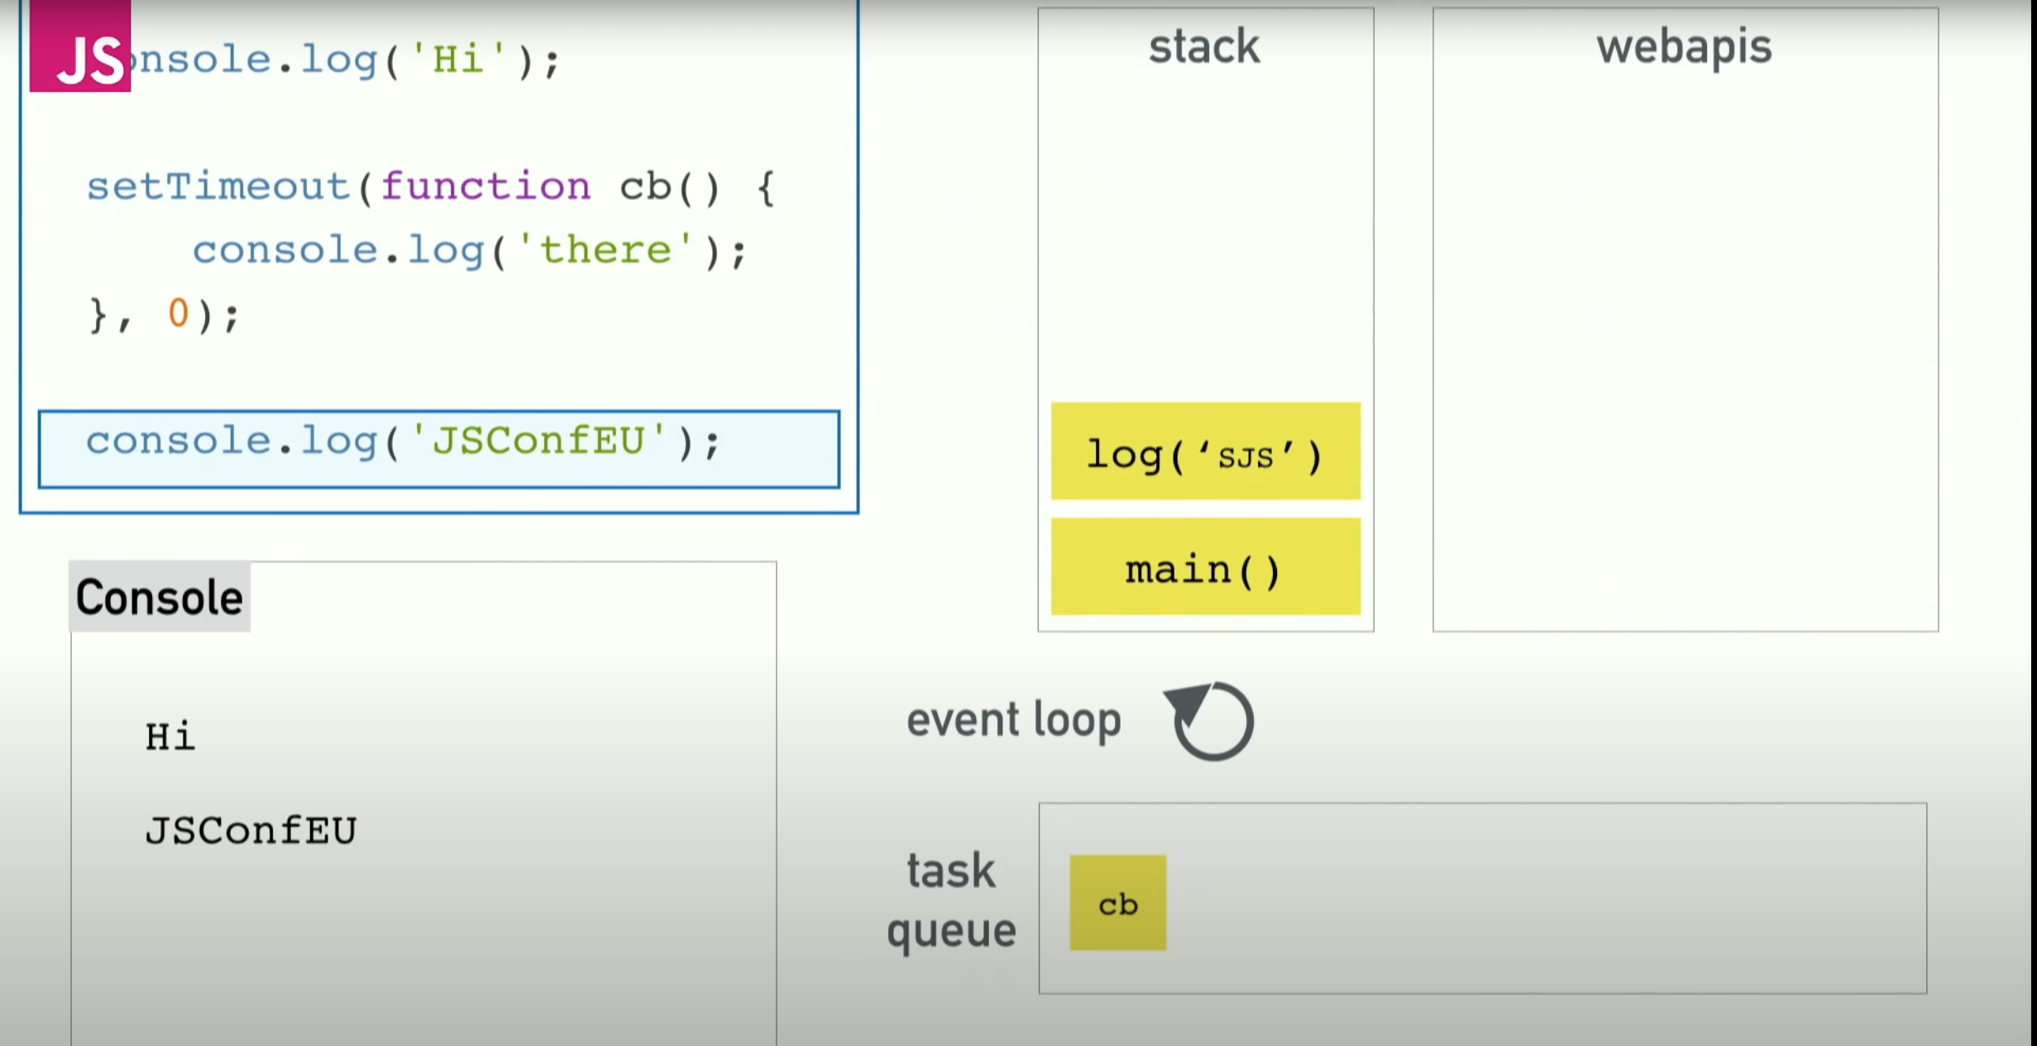
Event Loop

Slide 58
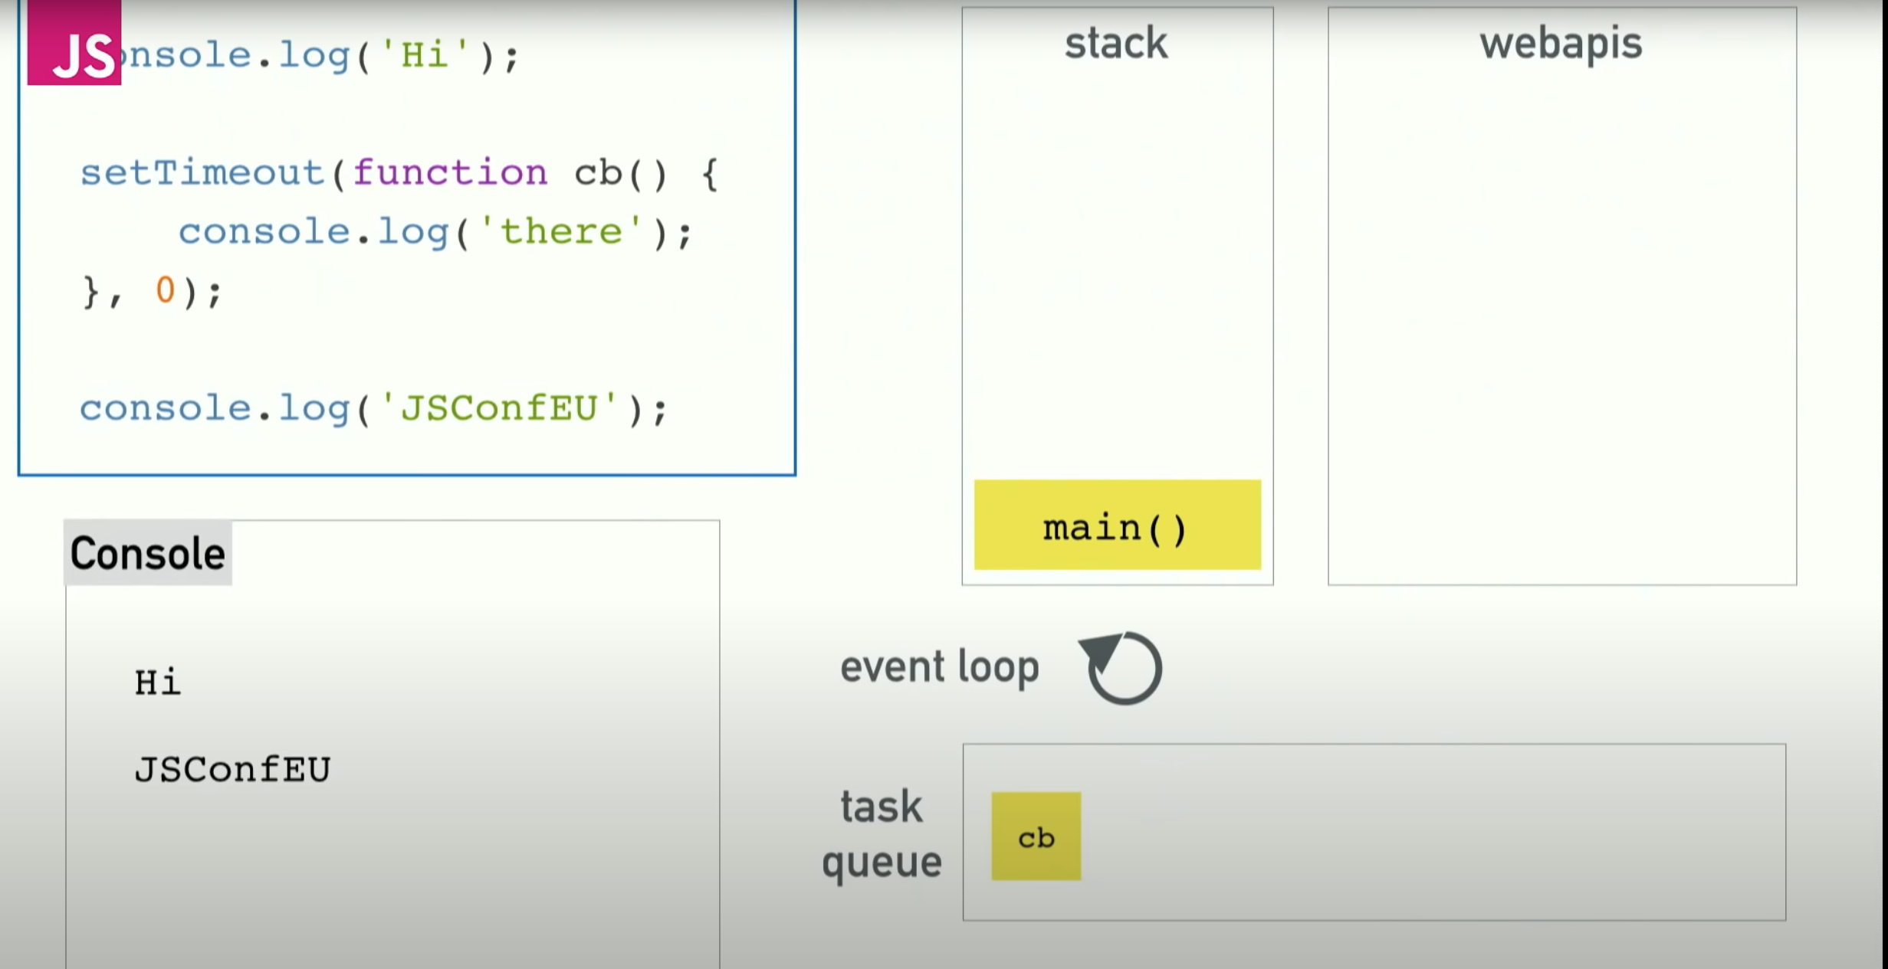
Event Loop

Slide 59
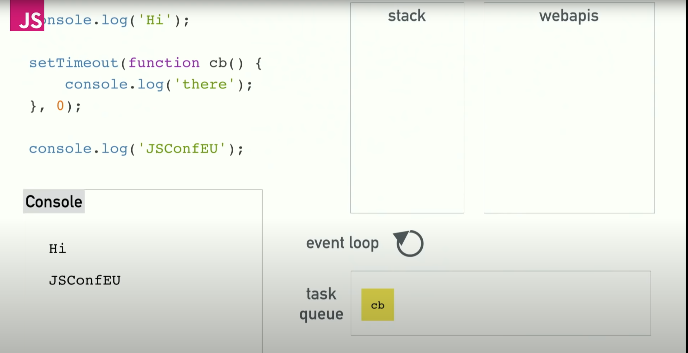
Event Loop

Slide 60
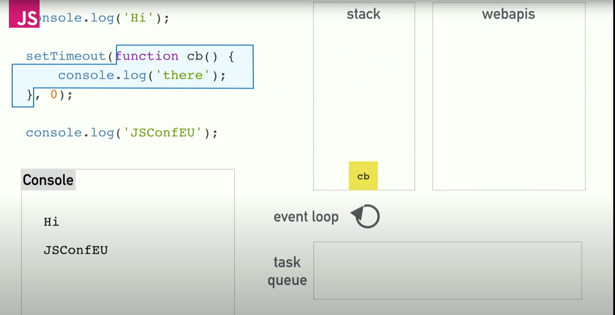
Event Loop

Slide 61
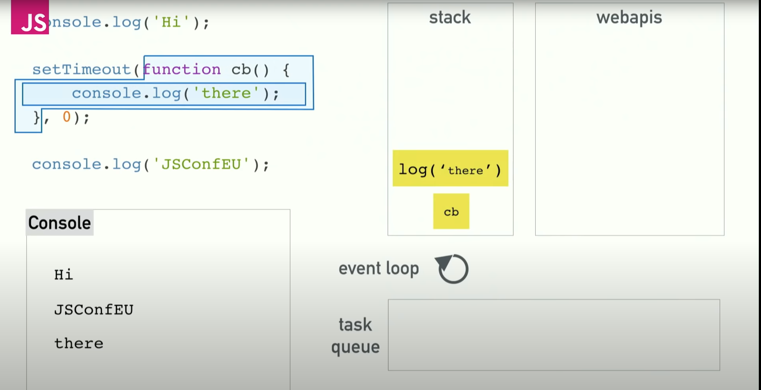
Event Loop

Slide 62
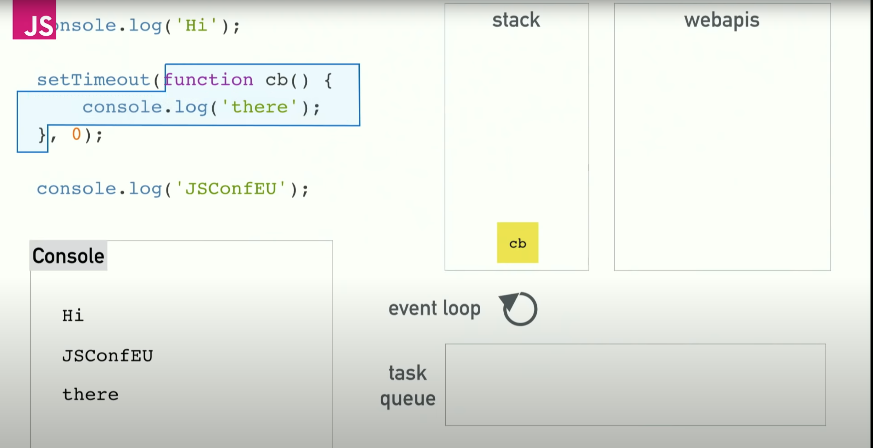
Event Loop

Slide 63
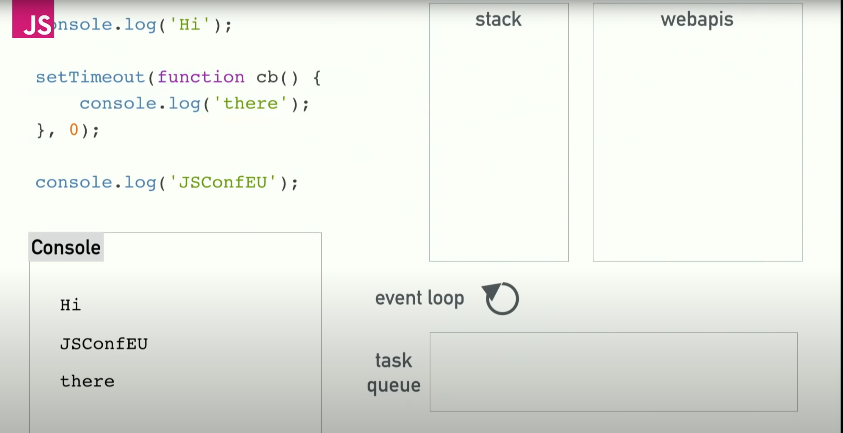
Event Loop

Slide 64

Event Loop – Another Example

Slide 65

Event Loop

Slide 66

Event Loop

Slide 67

Event Loop

Slide 68

Event Loop

Slide 69

Event Loop

Slide 70

Event Loop

Slide 71

Event Loop

Slide 72

Event Loop

Slide 73

Event Loop

Slide 74

Event Loop

Slide 75

Event Loop

Slide 76

Event Loop

Slide 77

Event Loop

Slide 78

Event Loop

Slide 79

The End

